Slide 1
Districtwide Classified Professional Development Committee
June 5, 2015
Classified Leadership Institute Presentation

Slide 2
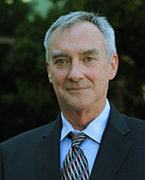
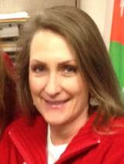
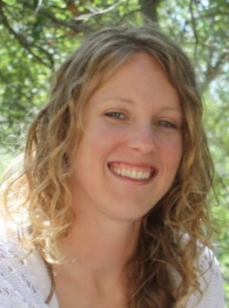
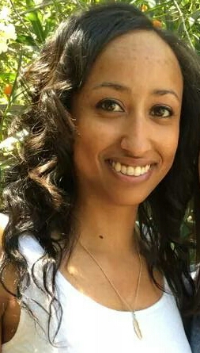
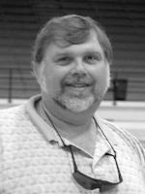
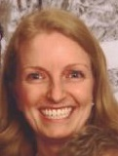
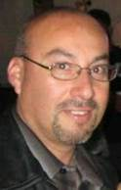
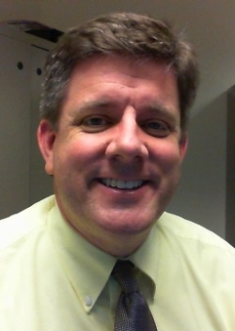
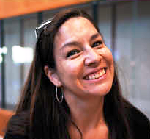
Educate and Motivate
Michael Shanahan
Patti Blair
Ashley Chelonis
Leanne Colvin
Sharon Oxford
Peder Nielsen
Personal Professional Development Plan
Campus Tours
Classified Employee of the Year
Sophia Crocker
Krista Mendelsohn
Joe Esquivel
Matthew Moore
Ashley Lajoie
Olivia Long

Slide 3
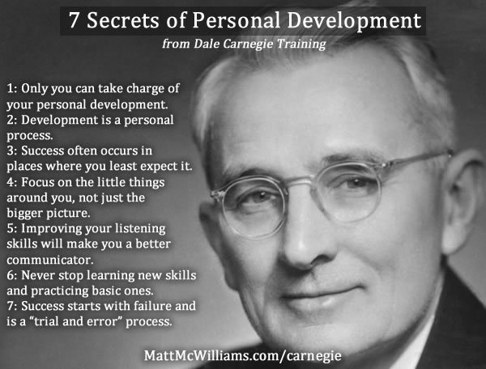

Slide 4
Introduction to the Personal Professional Development Plan (PPDP)
To provide clear, accessible resources for classified employees to develop a growth plan specific to their professional goals and in collaboration with their supervisor
To encourage employees to participate and establish goals, make conscious choices, and take action
Voluntary
Collaborative
Support and Feedback
Accountability

Slide 5
The PPDP
Discuss:
Employee Goals
Future Opportunities and Development Objectives
Current Training to Maintain and Enhance
Training for Growth
Resources Needed
Success Factors
Action Plan
Coaching/Mentoring Opportunities
Benchmarks

Slide 6
Employee and Leader Roles in the PPDP Process “Collaborate”
Employee Role
Leader Role
Provide support
Suggest mentor(s)
Review goals and provide feedback
Encourage progress
Delegate development opportunities (other duties as assigned)
Forward completed certificates to Human Resources
Acknowledge and congratulate
Identify opportunities
Establish goals
Just do it!
Track progress and compile certificates of completion and transcripts
Discuss successes and next steps

Slide 7
Development Resources Suggestions
Lynda.com
Mentor
College Courses
Workshops
Special Projects
Conferences
Professional Associations
State Clearinghouse

Slide 8
Feedback
What’s your feedback on -
Plan
Process/Roles
Resources
Benchmarks – what do you want to see from this program? How is success measured?

Slide 9
Peder Nielsen
Ventura College Classified Senate President
pnielsen@vcccd.edu
Olivia Long
VCCCD/SEIU Chief Union Steward
olivia_long1@vcccd.edu

