Slide 1
Accreditation, Program Review, AND THE Classified Professional
Classified Leadership Institute 2016
Hope Ell
Theresa Rees
Misty Burruel
Sherrie Guerrero

Slide 2
Accreditation

Slide 3
What is Accreditation?
Accreditation is the process by which educational institutions are evaluated to insure educational quality and institutional effectiveness.
Accreditation is assurance:
The college meets set standards
The college is eligible for financial aid
The education obtained there is of value and the units earned are legitimate

Slide 4
Four standards
Standard I: Mission, Academic Quality and Institutional Effectiveness, and Integrity
Standard II: Student Learning, Programs and Support Services
Standard III: Resources
Standard IV: Leadership and Governance

Slide 5
The proof is in the evidence
Being in Compliance and Constantly Improving
The Self-Evaluation and the Quality Focus Essay
Evidence, Evidence, Evidence
A Site Visit and Recommendations
The Commission’s Decision

Slide 6
What is the role of the classified professional?
The standards represent the work of the whole college, including classified professionals
In their department
Committees
Tri-chair model
Integrated planning connects the dots (standards)
Notes:
-Accreditation: Sherrie & Theresa
-PSR: Misty & Hope
III.A.9 The institution has a sufficient number of staff with appropriate qualifications to support the effective educational, technological, physical, and administrative operations of the institution (ER 8).
Evidence of Meeting the Standard
Through Program and Services Review, the college identifies needed classified positions and uses a prioritization process that identifies the programs with the most critical needs for classified positions (III.A.44, III.A.45).
The college used its lean years to offer opportunities to existing staff, which in turn, broadened and strengthened expertise. As funding has become available, vacancies have been filled, and new positions have been thoughtfully considered (III.A.37).

Slide 7
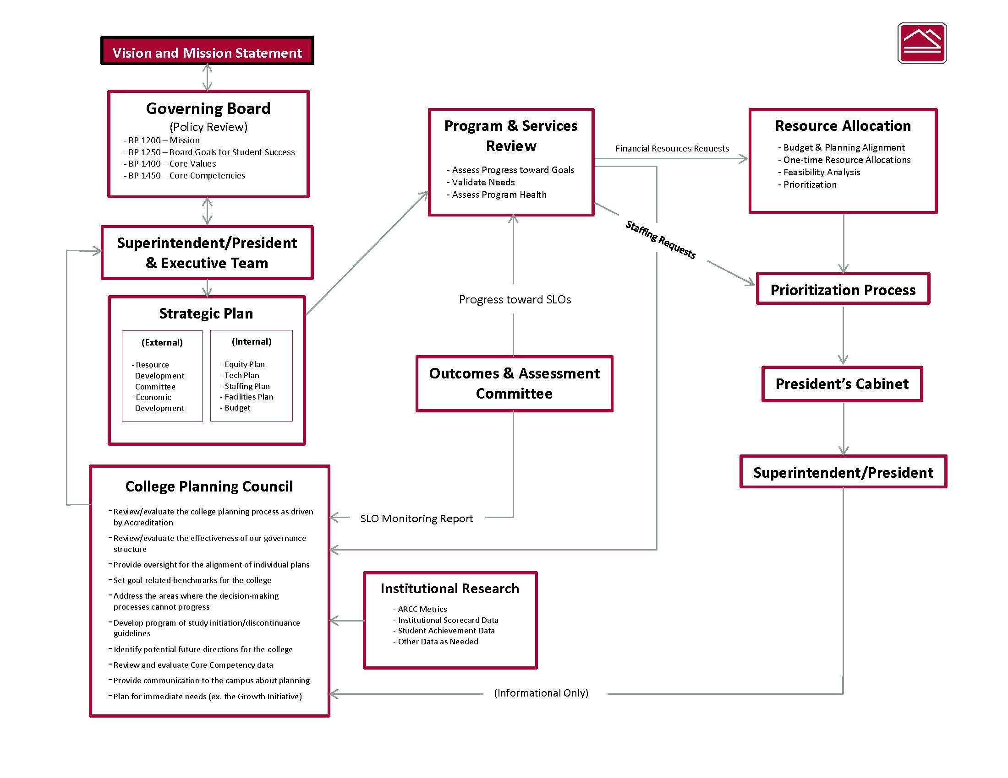

Slide 8
Program review

Slide 9
Integrated planning and program review
What is the relationship between integrated planning and program review?
I.B.9: The institution engages in continuous, broad based, systematic evaluation and planning. The institution integrates program review, planning, and resource allocation into a comprehensive process that leads to accomplishment of its mission and improvement of institutional effectiveness and academic quality. Institutional planning addresses short- and long-range needs for educational programs and services and for human, physical, technology, and financial resources.

Slide 10
What is program review?
I.B.5: The institution assesses accomplishment of its mission through program review and evaluation of goals and objectives, student learning outcomes, and student achievement. Quantitative and qualitative data are disaggregated for analysis by program type and mode of delivery
Program review is referenced throughout the accreditation standards
Institutions have to provide evidence of program review
Establish goals based on data analysis
Long- and short-term planning
Resource allocation
Notes:
-Provide examples of program review references in the standards (III.B.I-Facilities)
-Show examples after this slide.

Slide 11
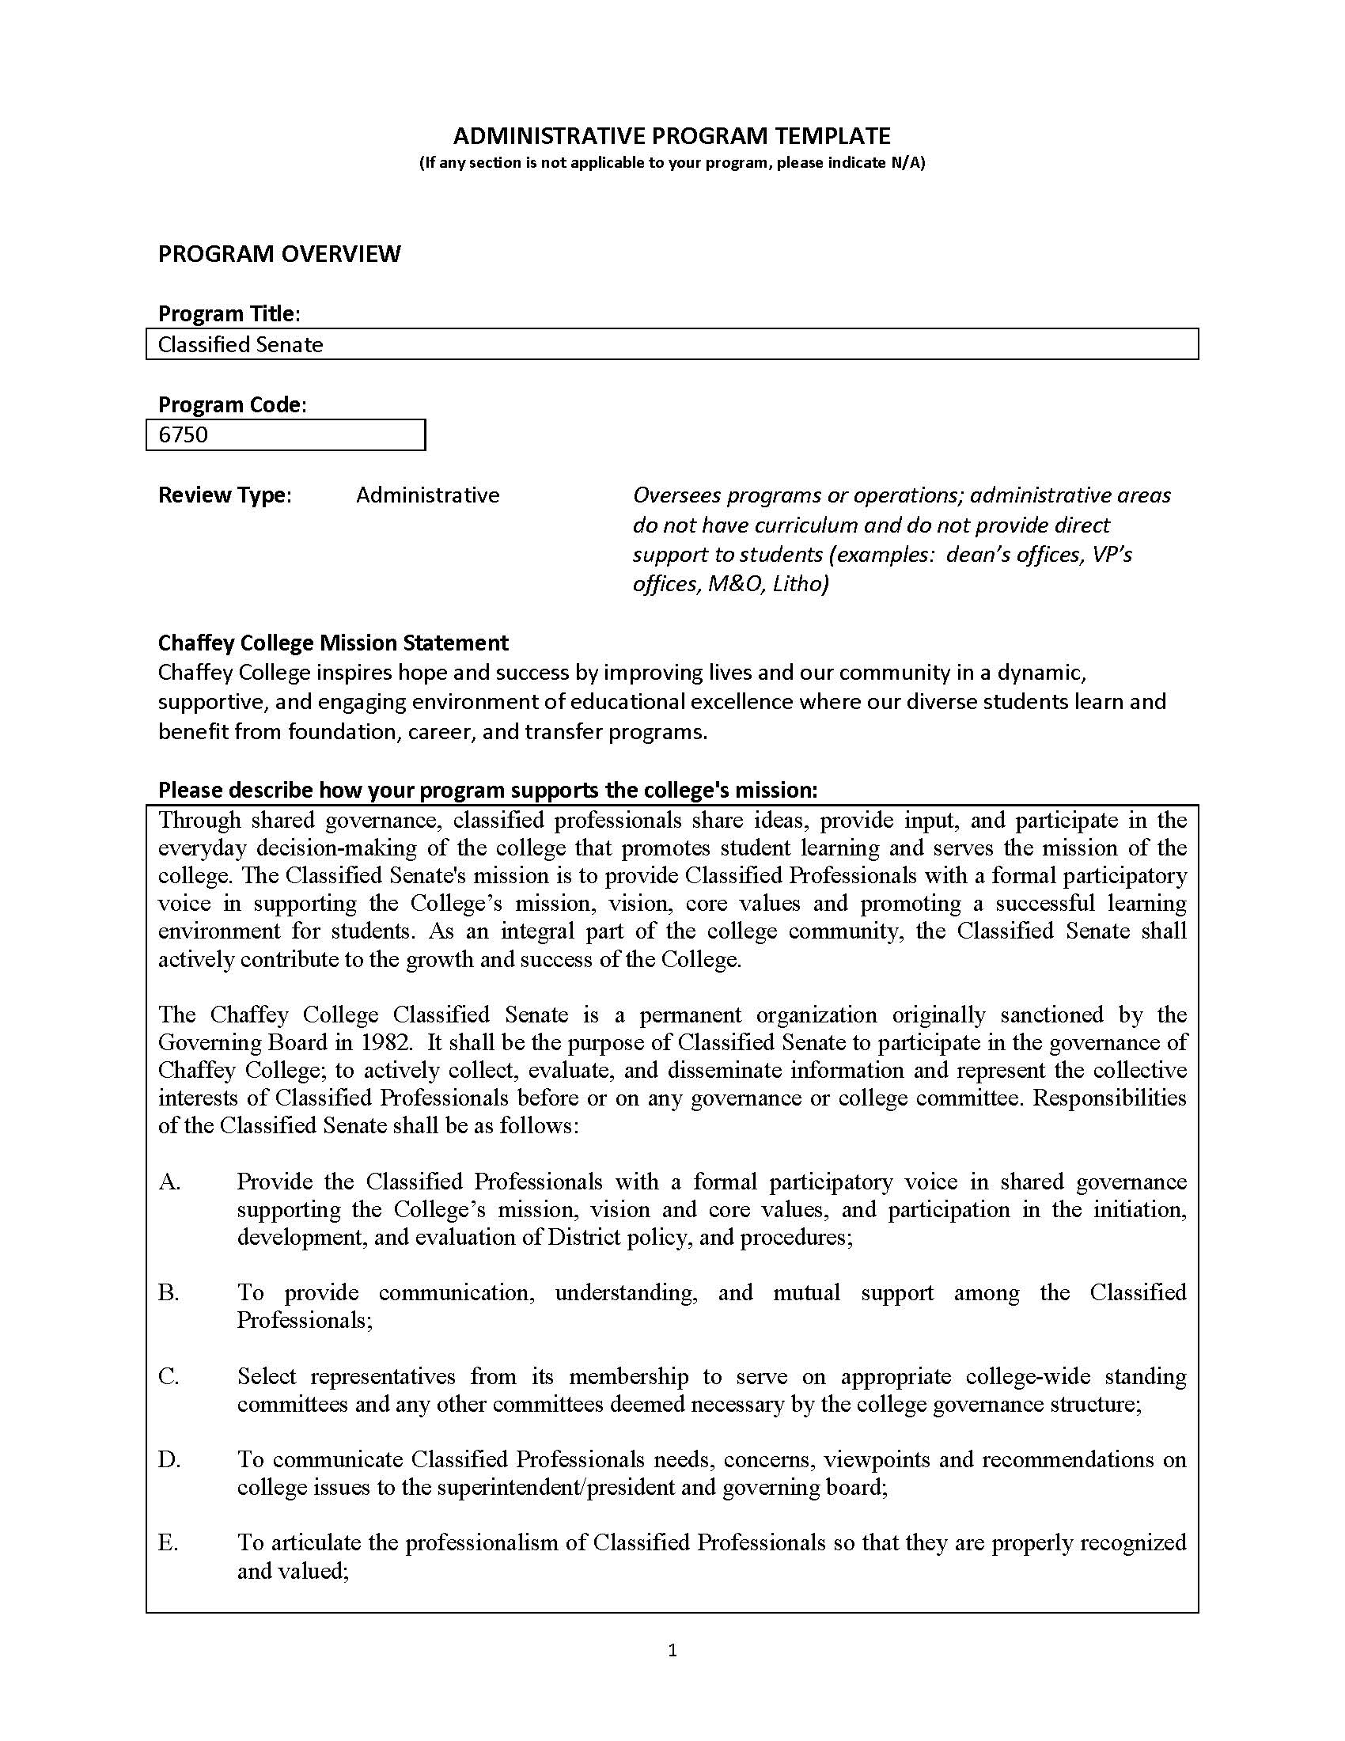

Slide 12
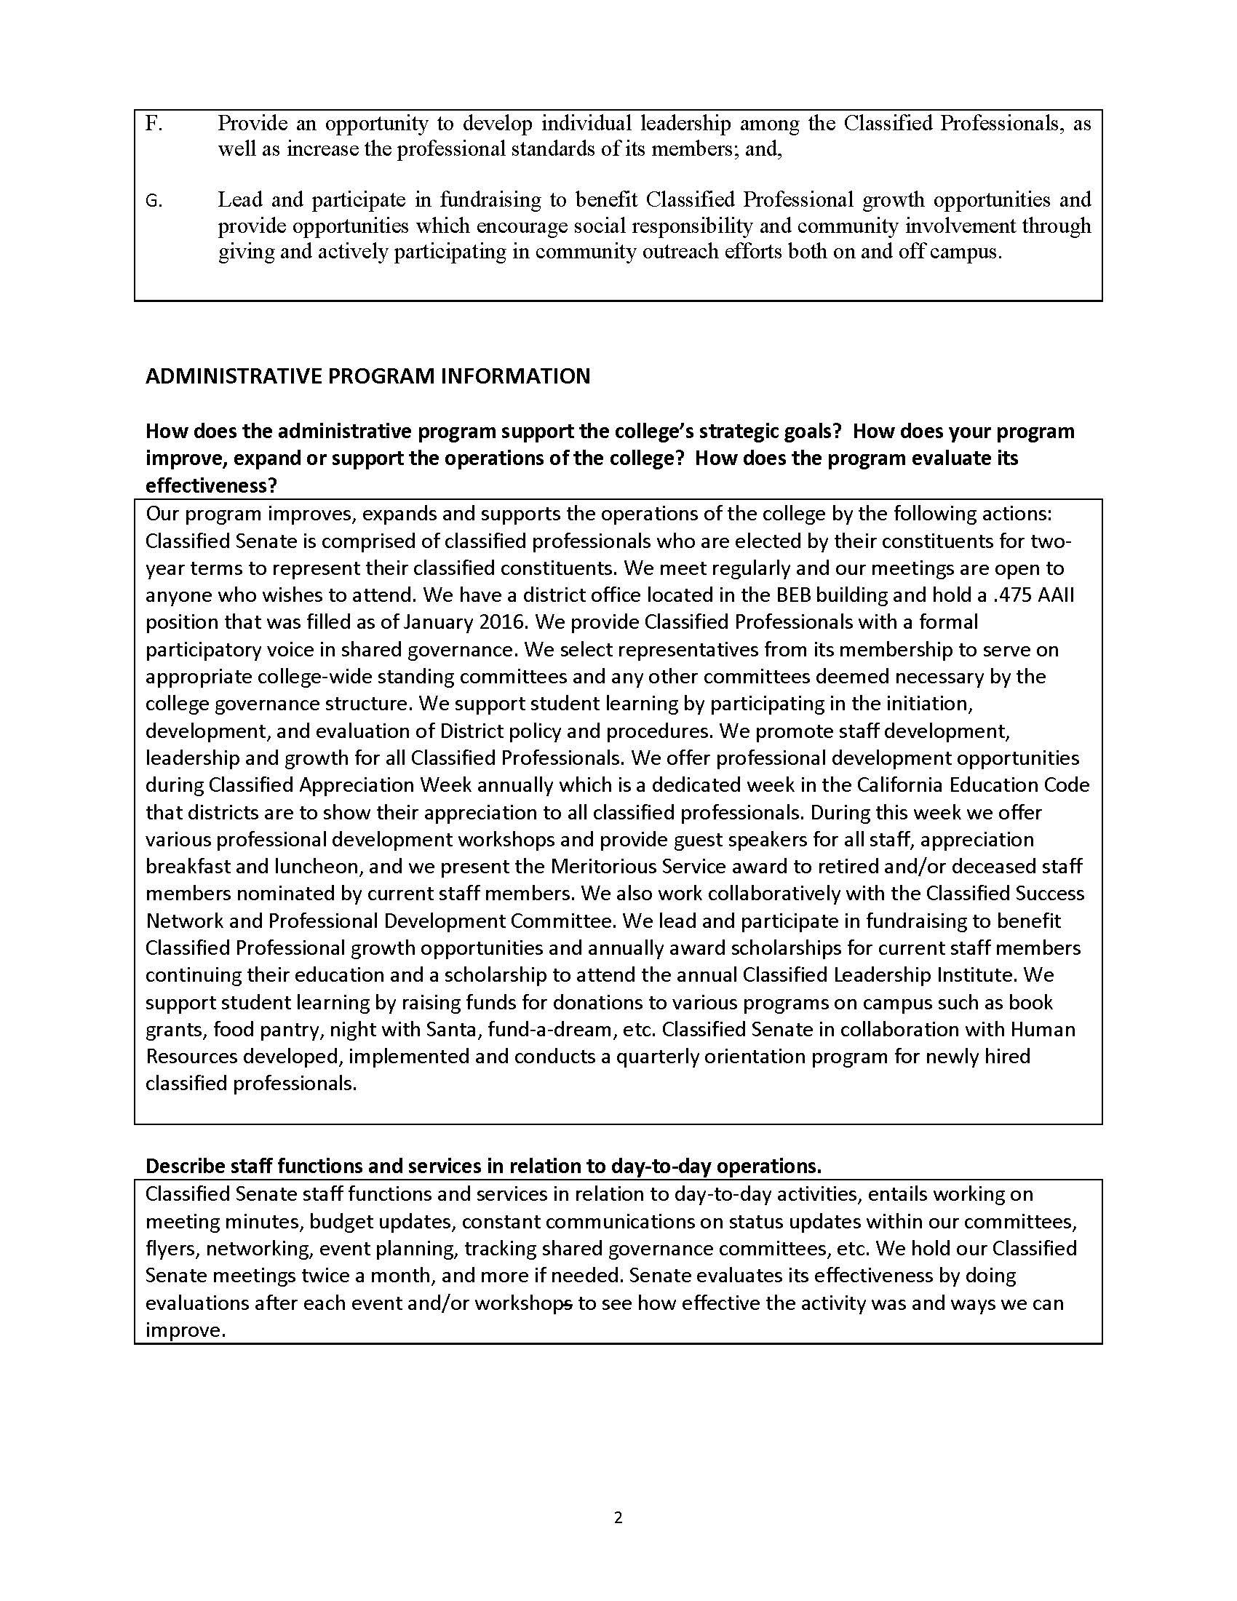

Slide 13
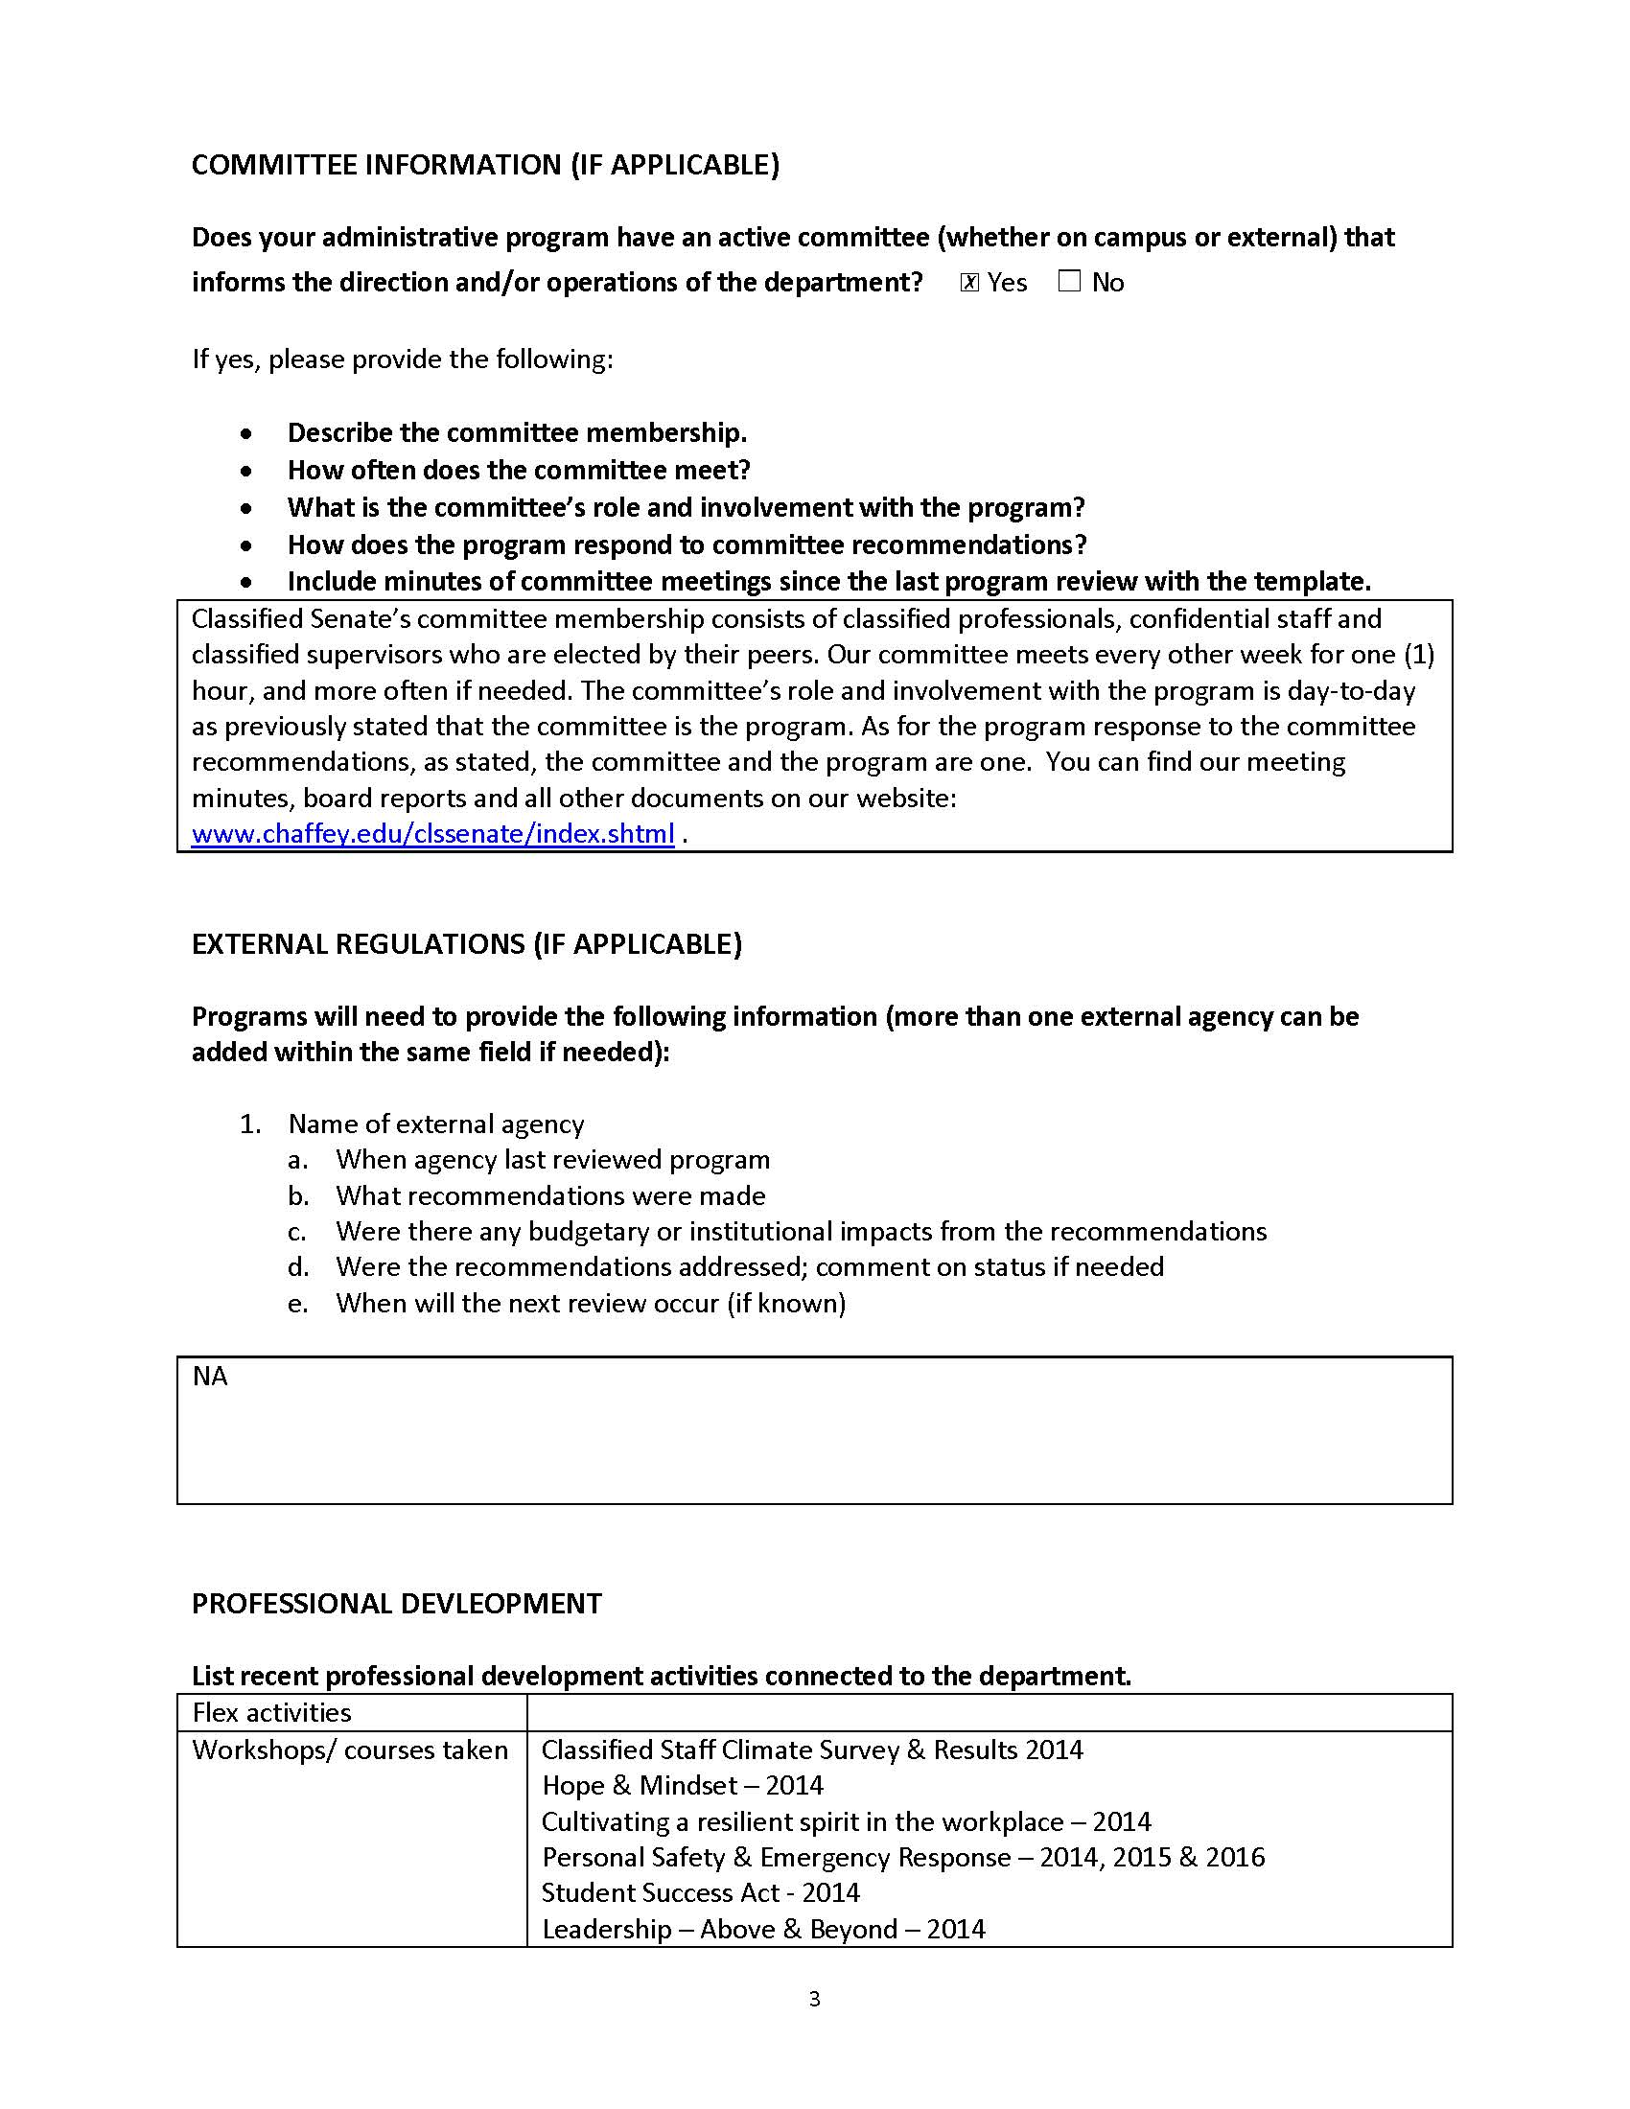

Slide 14
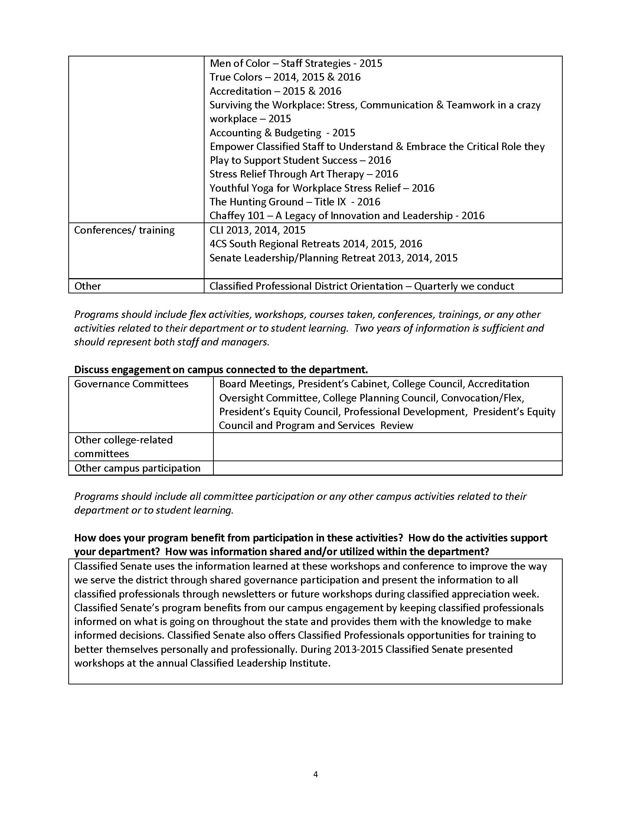

Slide 15
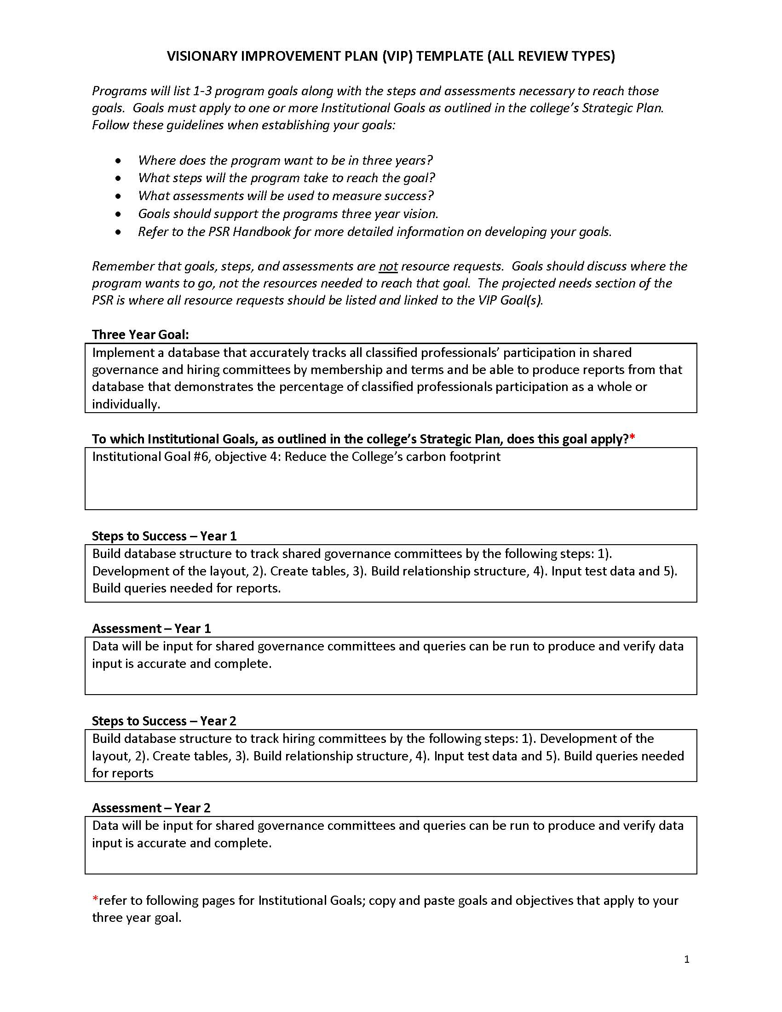

Slide 16
VIP Goal | Strategic Plan Goal | Accreditation Standard
Implement a database that accurately tracks all classified professionals’ participation in shared governance and hiring committees by membership and terms and be able to produce reports from that database that demonstrates the percentage of classified professionals participation as a whole or individually. | Institutional Goal 3, Objective 3: Implement appropriate training orientation and professional development for all employee groups. | IV.A.1 III.A.14
Implement a cloud-based filing system that will allow Classified Senate Officers, Senators, and Administrative Assistant to track, share, and store documents used in the planning of campus events. | Institutional Goal 6, Objective 4: Reduce the College’s carbon footprint. | I.B.1 IV.A.1

Slide 17
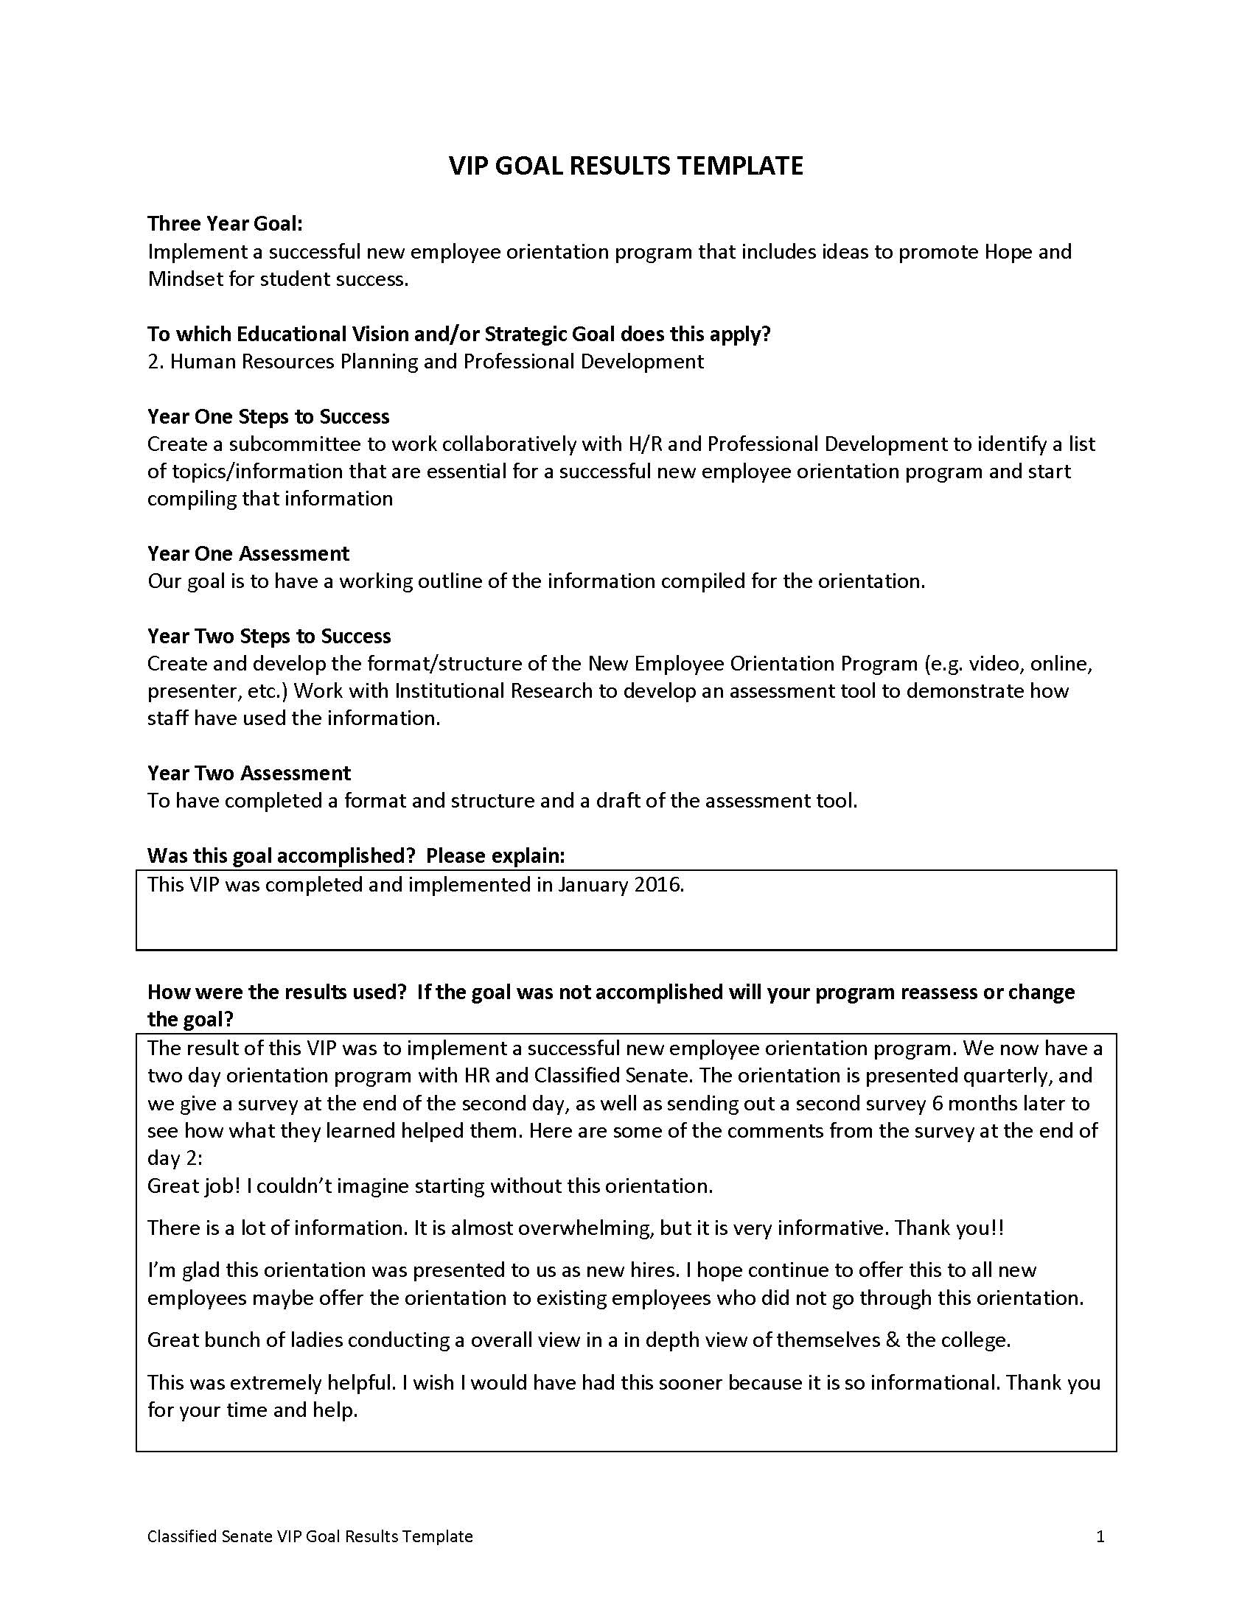

Slide 18
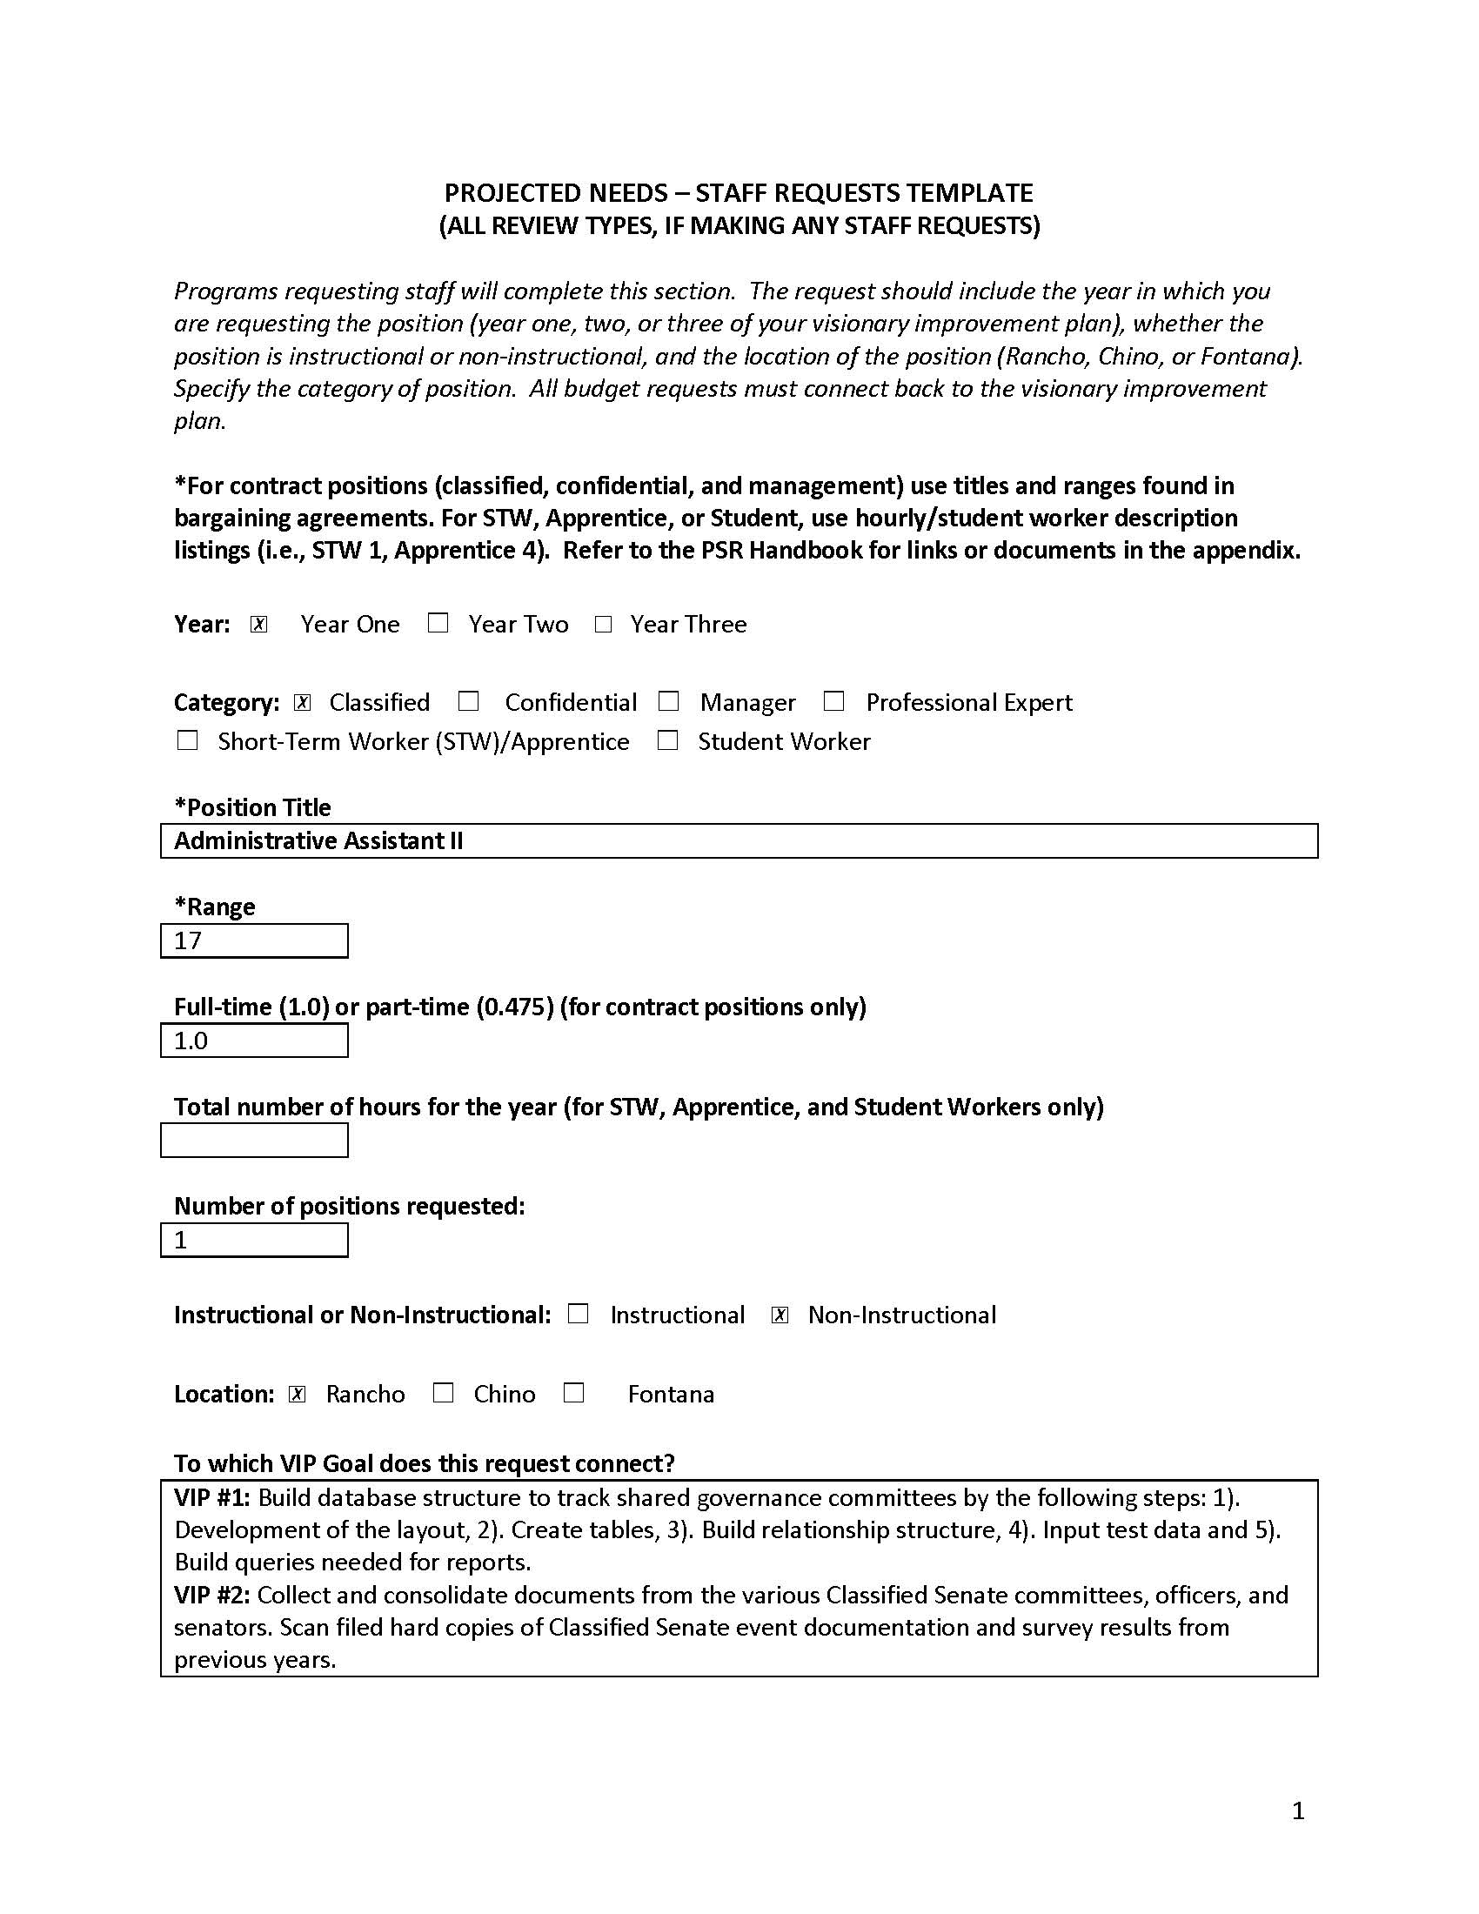

Slide 19
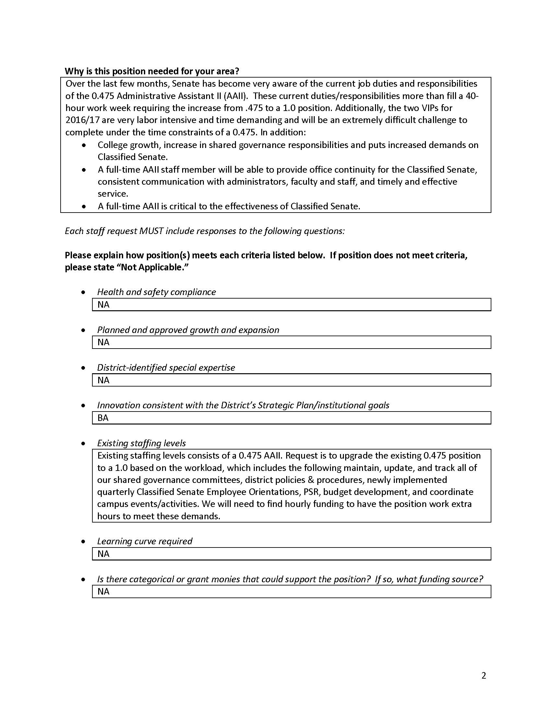

Slide 20
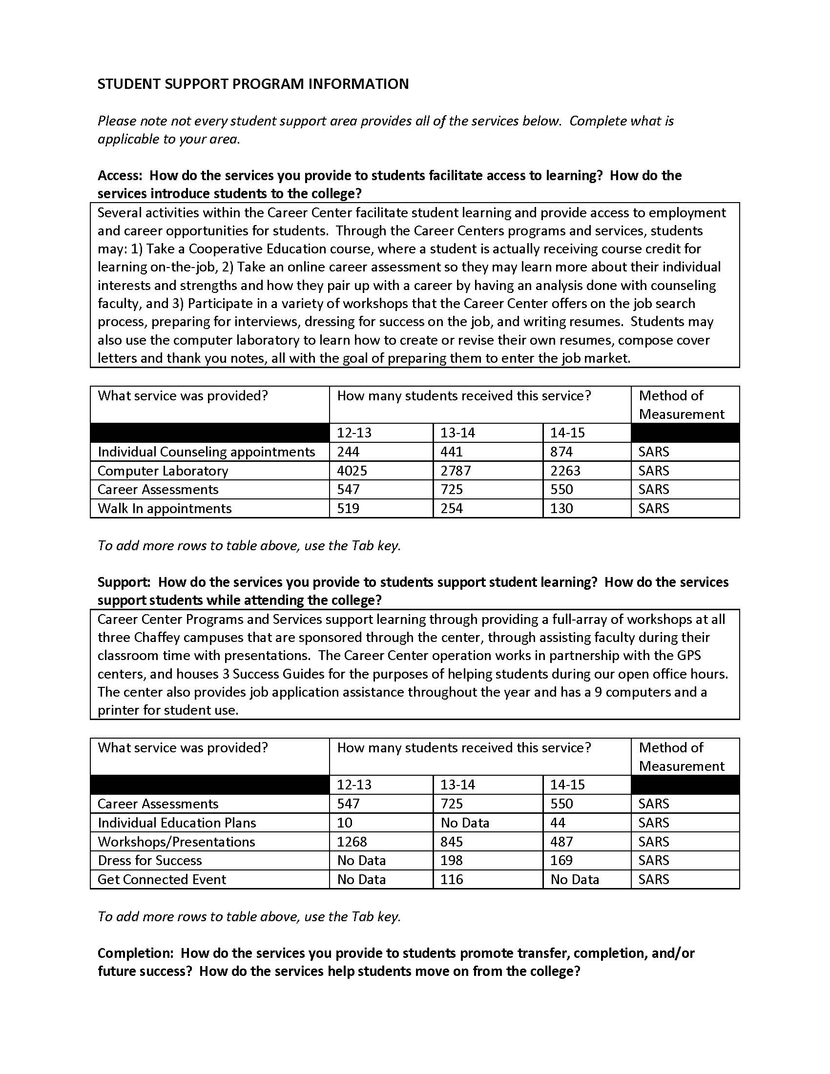

Slide 22
What is the role of the classified professional?
Everyone has a role in program review
In their department
On the committee
Tri-chair model

Slide 23
QUESTIONS?

Slide 24
THANK YOU!
LINKS
ACCJC Accreditation Standards
http://www.accjc.org/wp-content/uploads/2014/07/Accreditation_Standards_Adopted_June_2014.pdf
Chaffey College – Accreditation Website
http://libguides.chaffey.edu/accreditation
Chaffey College – College Planning Council
http://www.chaffey.edu/profdev/IP/index.html

