Slide 1
Guided Pathways:
Looking Forward, Looking Back
Laura Hope, Executive Vice Chancellor of Educational Services and Support
Classified Leadership Institute
June 15, 2018
Notes:
Momentous year—Vision for Success
Acquainted with the framework
Self-Assessment
Multi-year workplans
Allocations went out
Reading Circle
Still at the starting line

Slide 2

Goal 1:
Guided Pathways
Vision for Success
Increase by at least 20 percent the number of CCC students annually who acquire associates degrees, credentials, certificates, or specific skill sets that prepare them for an in-demand job.
Goal 2:
Increase by 35 percent the number of CCC students system-wide transferring annually to a CSU or UC, necessary to meet the state’s needs for workers with baccalaureate degrees.
Goal 3:
Decrease the average number of units accumulated by CCC students earning associates degrees from approximately 87 to 79 total units—the average among the top 5th of colleges showing the strongest performance on this measure.
Notes:
Vision for Success represents aspirational goals—ambitious—but we have always been as a system

Slide 3
Goal 4:
Guided Pathways
Increase the percentage of exiting CTE students who report being employed in their field of study, from the statewide average of 60% to 69%--the average among the top 5th of colleges showing the strongest performance on this measure.
Goal 5:
Reduce equity gaps by 40% across all of the previous measures through faster improvements among traditionally underrepresented students, closing the gap within 10 years.
Goal 6:
Reduce regional achievement gaps across the previous measures through faster improvements among colleges located in regions with the lowest educational attainment of adults, with the goal of closing the gap within 10 years.
Notes:
OK

Slide 4
The Need for Reform
9% of students complete transfer-level mathematics and English in one year
After 6 years, 17% of California’s community college students are still enrolled and haven’t earned a degree or credential
67% of the System’s students identify transfer as their goal

Slide 5
Source: CCRC analysis of NSC data on the fall 2010 FTEIC, degree-seeking community college cohort.

Slide 6
Fundamental Starting Point
We have been working hard for students
Our efforts have not resulted significant gains for student achievement and equity
This is a national movement with evidence to support it
Fidelity and flexibility in the framework
Notes:
Chancellor considers GP as primary vehicle to take the system to next level—animate the vision for success

Slide 7

Legacy Moment in California

Slide 8

The California
Guided Pathways Context
AACC Colleges
Independent Efforts
Demonstration Project
Notes:
GP occurring in stages—explain each—framework not a cookie cutter—flexible but fundamental commonalities

Slide 9
Self-Assessment Results
4%
Pre-Adoption
20%
In Progress
76%
Early Adoption

Slide 10
Themes from Self-Assessment
Common concerns: resistance, resources, integration, funding
Common strengths: curiosity for the guided pathways framework, belief in the potential to increase achievement, good work already underway but not at scale

Slide 11
Themes from the Multi-Year Plan
Broaden engagement
Create cross-functional team structures
Review governance systems
Clarify decision-making and communication
Develop a common glossary
Plan interest clusters and curriculum maps

Slide 12
Structural Not Programmatic Reform
Programmatic Reform
Small locus of control
Limited scale
Limited impact
Doesn’t impact the culture
Structural Reform
Collaborative control
Absolute scale
Maximum impact
Cultural reform

Slide 13
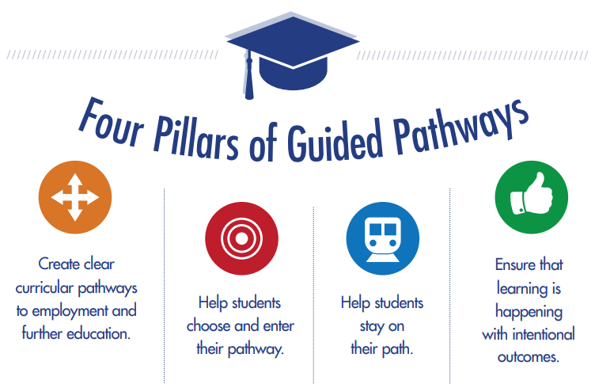

Slide 14
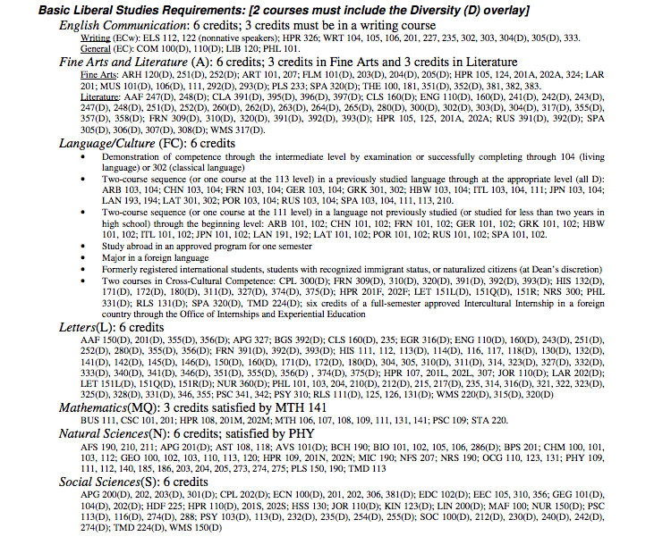
GENERAL EDUCATION REQUIREMENTS
(Select 12 courses from this list of more than 300)
The Challenge of GE

Slide 15
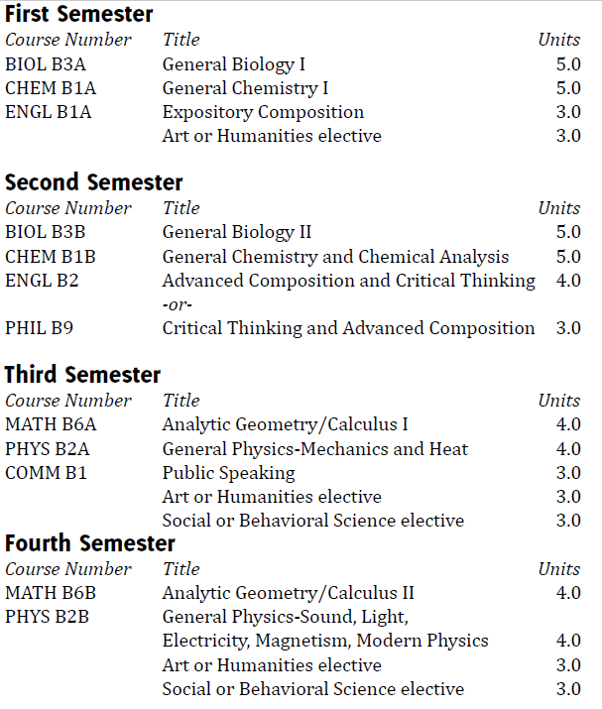

Slide 16
Guided Pathways Support
Central Valley regional support primed for expansion
Field Notes
Online learning
GP Connect
Role-Alike convenings
Guided “collaboratory” events
Campus pairing

Slide 17
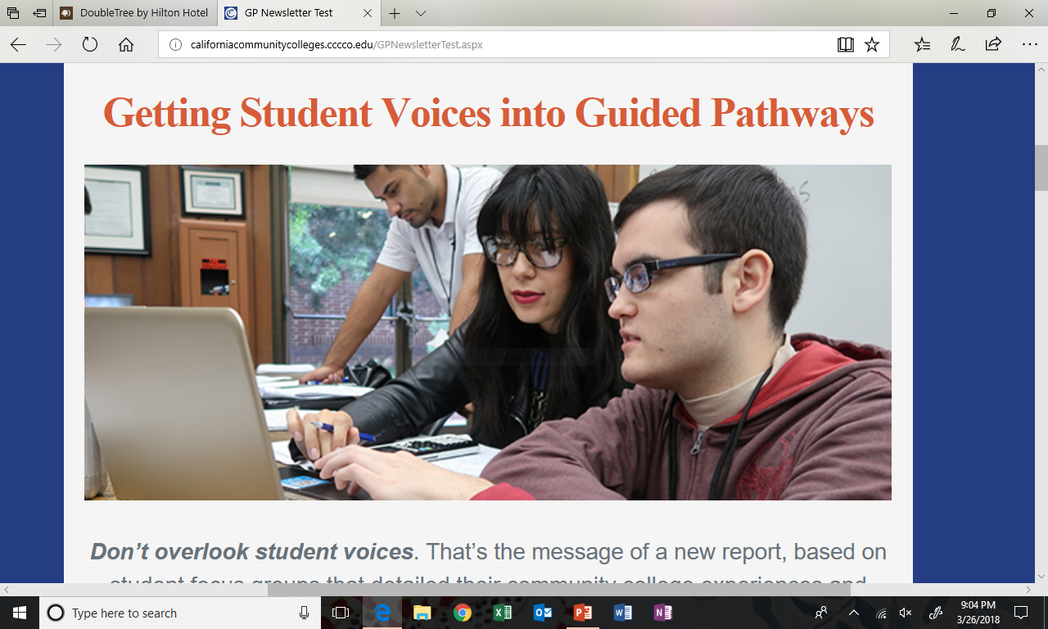

Slide 18
Synergy of Efforts to the Vision and Guided Pathways
Policy Connections:
AB 705 and Basic Skills Reforms
AB 19 to support affordability
Intersegmental alignment with the ADTs
Regulatory Reform
Fiscal Reform:
Categorial funds and integration
GP allocations
Funding formula proposal
Professional Development and Planning Alignment
Metrics simplification
Professional Learning Network amplification and capacity-building
NOVA and systemic tool support

Slide 19

Lead from Where You Stand

Slide 20
Taking Steps Forward
Join the dialog
Use your unique voice and experience
Take a leading role
Support others’ leadership steps
Help connect dots to “invisible worlds”
Engage commitment to the work and students
Disrupt constructively

Slide 21
Questions or Reflections

