Slide 1
Classified Leadership Institute 2012
Celebrating
Outstanding Classified
Employees
from across
our state
Welcome Aboard

Slide 2
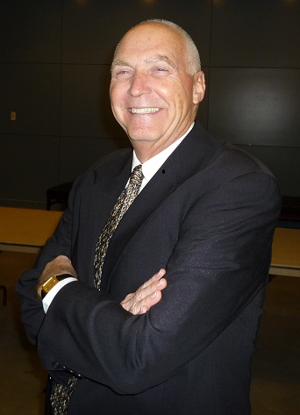
Irvine Valley College
Dennis Gordon
Classified Senate President

Slide 3
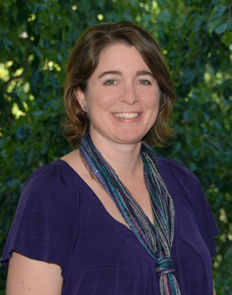
San Joaquin Delta College
Staci Miller
Classified Senate President

Slide 4
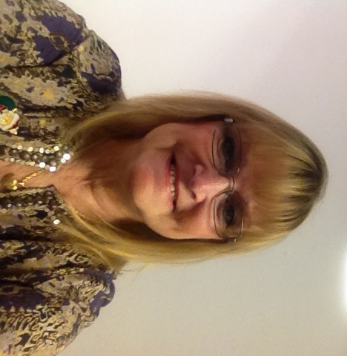
Mt San Jacinto College
Elaine Eshom
Academic Senate Secretary
Classified Senate President

Slide 5
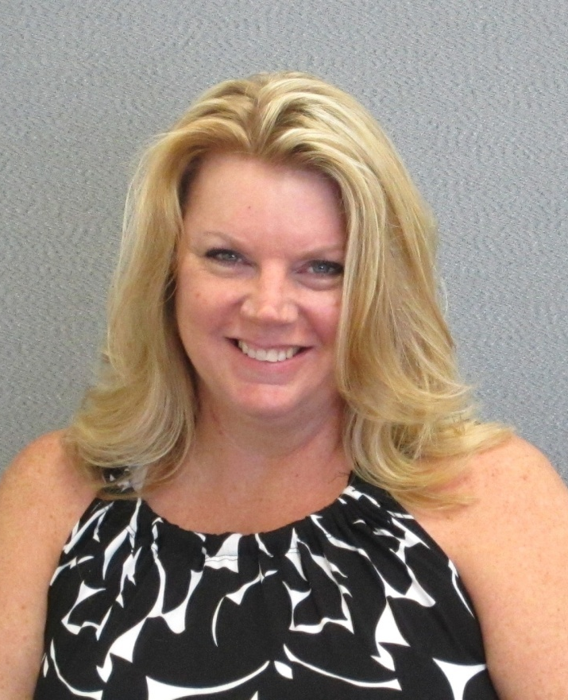
Chaffey College
Trisha Albertsen Accountant - Classified Senate President

Slide 6
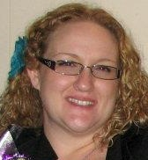
San Bernardino Valley College
Cassandra Thomas
Chemistry Lab Technician
Classified senate President

Slide 7
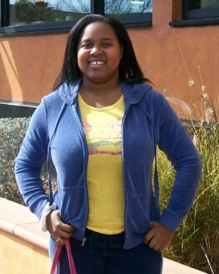
San Diego City College
Awana Payne
Senior Clerical Assistant
Classifies Senate President

Slide 8
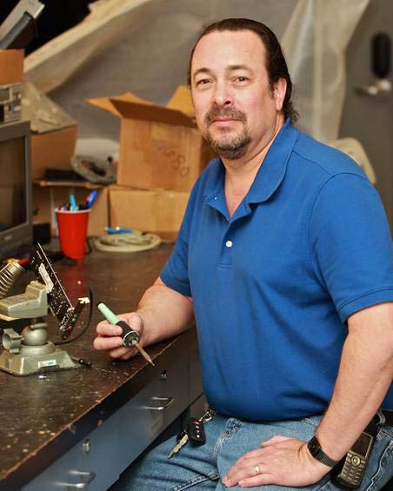
Irvine Valley College
Barry Miller
Senior Multi-Media Technician
Classified Employee Outstanding Service Award for 2012-2013

Slide 9
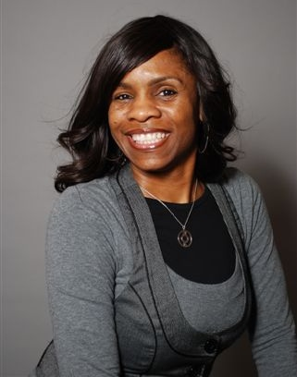
Chaffey College
Anita Fletcher
Financial Aid Advisor
Classified Senate CLI Scholarship

Slide 10
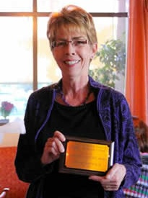
MiraCosta College
Ann Quebedeaux
Instructional Division Secretary
Outstanding Employee of the Semester - Fall 2011

Slide 11
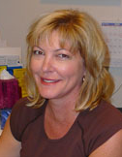
MiraCosta College
Kathy Thiele
Instructional Division Secretary
Outstanding Employee of the Semester - Spring 2012

Slide 12
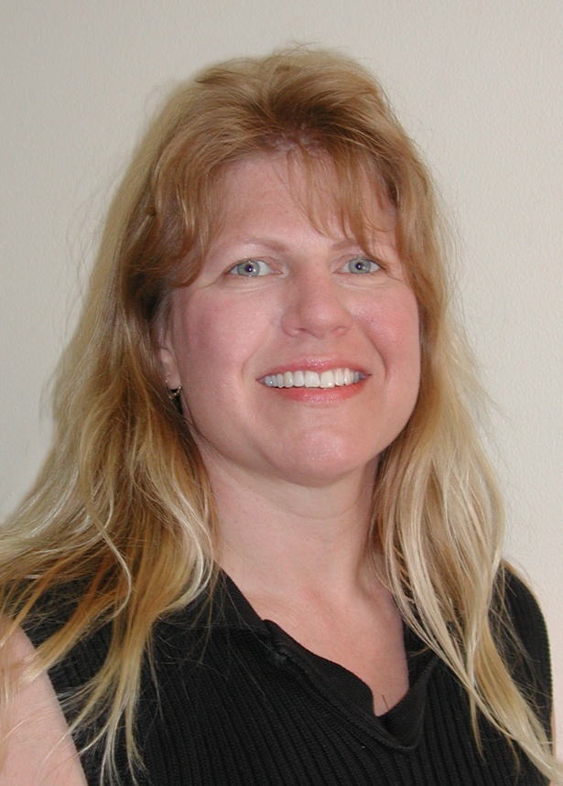
Lake Tahoe Community College
Pat Leonard-Heffner and Kathy Strain
Classified Employee Senate Co-Presidents

Slide 13
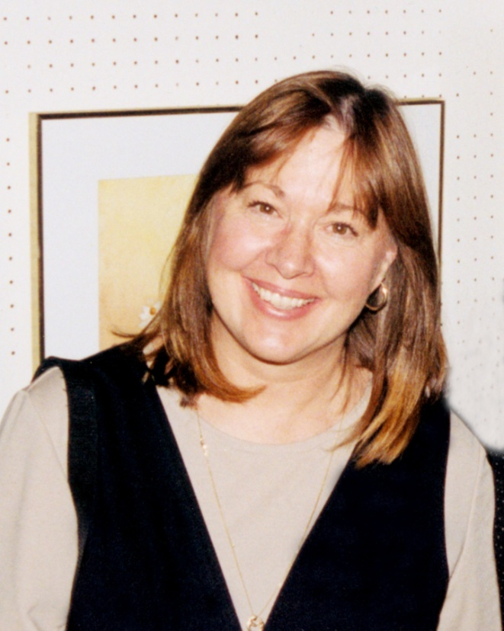
Lake Tahoe Community College
Kathy Strain and Pat Leonard-Heffner
Classified Employees Senate Co-Presidents

Slide 14
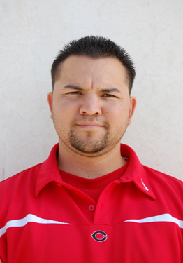
Chaffey College
German Paez
Athletics
Fall - Kudos Award

Slide 15
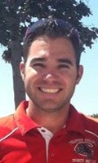
MiraCosta College
Justin Caudill
Athletics
Fall- Kudos Award

Slide 16
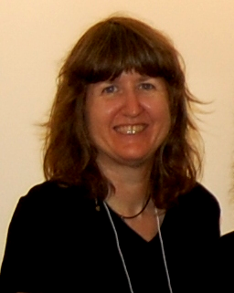
Chaffey College
Carla Castella
Instructional Assistant IV - Writing Center
Spring - Kudos Award

Slide 17
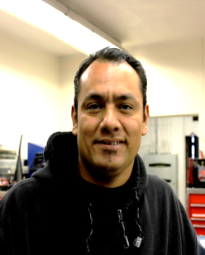
Chaffey College
Albert Venegas
Instructional Assistant III - Auto Shop
Spring - Kudos Awards

Slide 18
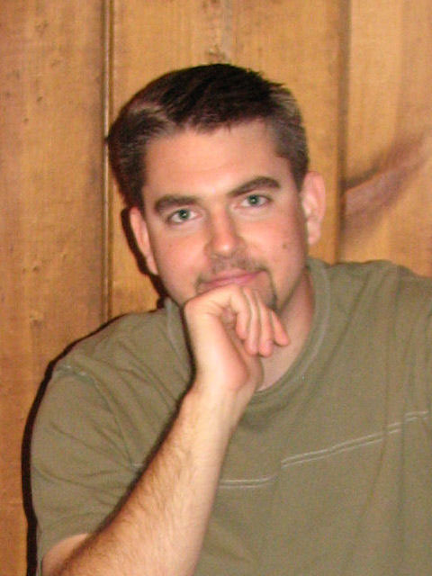
Cerro Coso Community College
Paul Kuttig
IT Technician
Classified Senate President

Slide 19
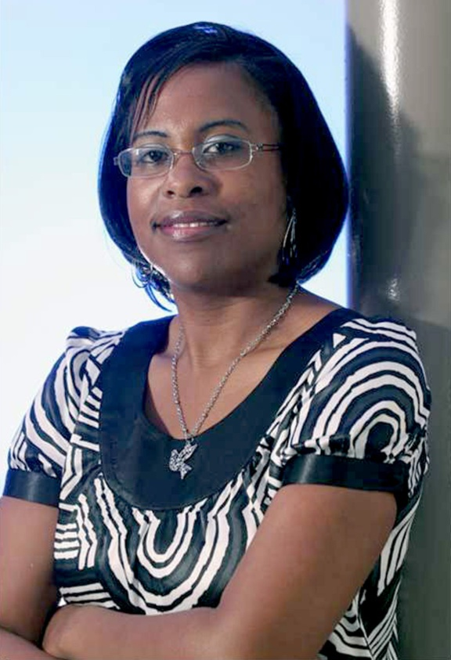
Contra Costa College
Shondra West
Sr. Administrative Assistant
Classified Employee of the Spring 2012 Semester

Slide 20
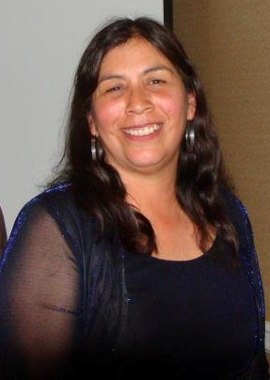
Copper Mountain College
Cecelia Yanez
Custodian
Classified Senate President

Slide 21
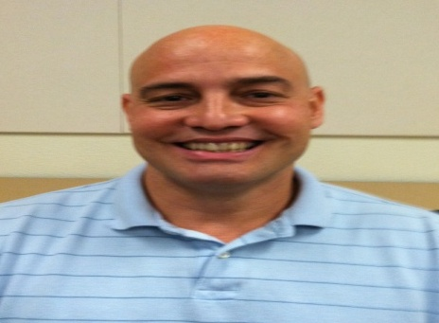
Butte College
Dan Buzan
Library Media Technician
1012 Initiative Awards for Excellence

Slide 22
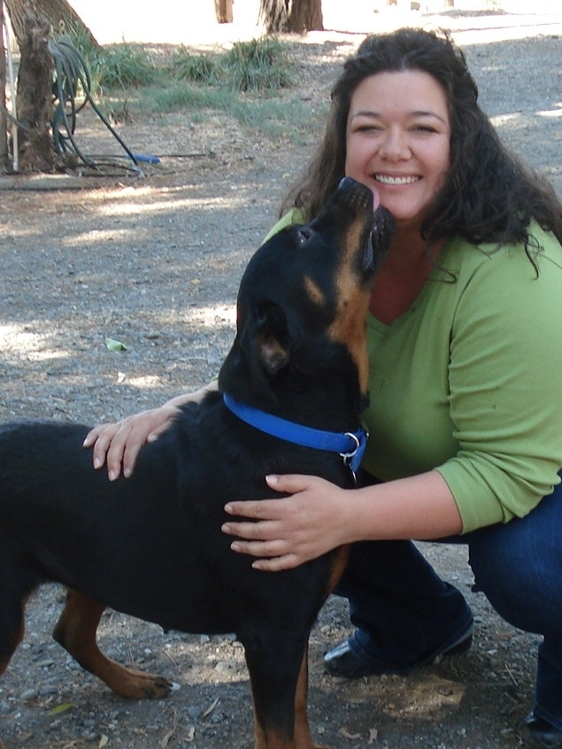
Chabot College
Lisa Carlsen
Instructional Assistant II
The Linda and Bob Carlson Classified Professional of the Year Award

Slide 23
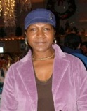
Las Positas College
Pam
Bracy-Levingston
Custodian
Outstanding Classified Professional Award

Slide 24
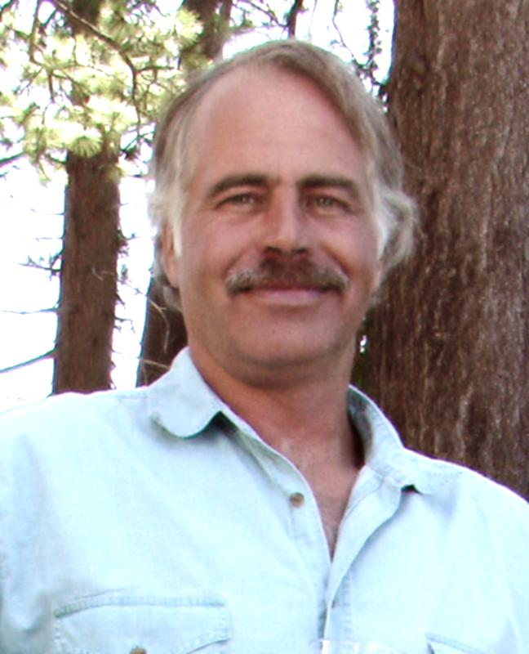
Butte College
Peter Dahl
Media Production Specialist
Excellence in Customer Service & Classified Senate President

Slide 25
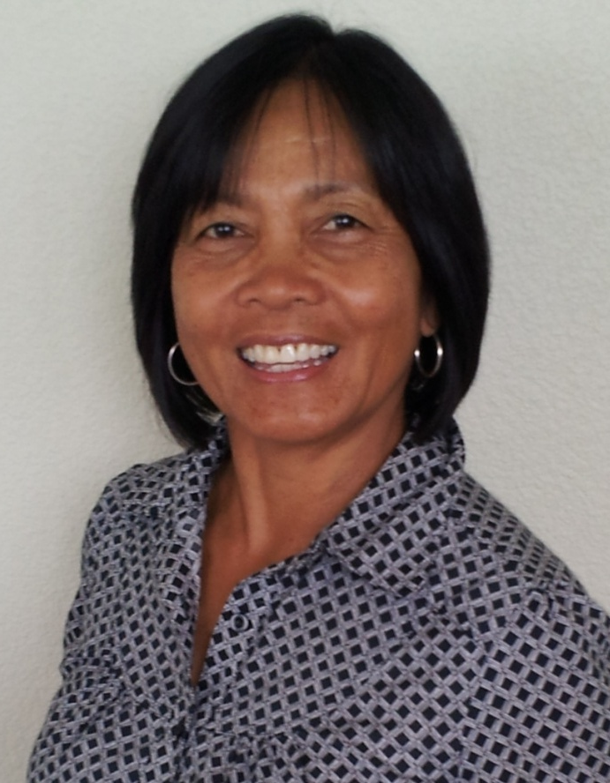
Butte College
Elisa Senko
Account Clerk Sr.
Excellence in Student Service

Slide 26
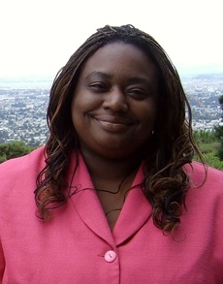
Merritt College
Doris Hankins
Staff Assistant/Vice President of Classified Senate
2012 California Community Classified Employee of the Year

Slide 27
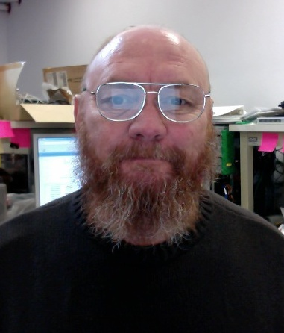
Merritt-Peralta CCD
Tony Hampton
Computer Network Technician
Constance L. Ormond Award

Slide 28
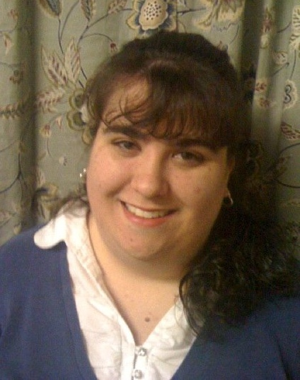
Butte College
Serena Gordon
Instructional Aide/Foreign Language Lab
Excellence in Customer Service Award

Slide 29
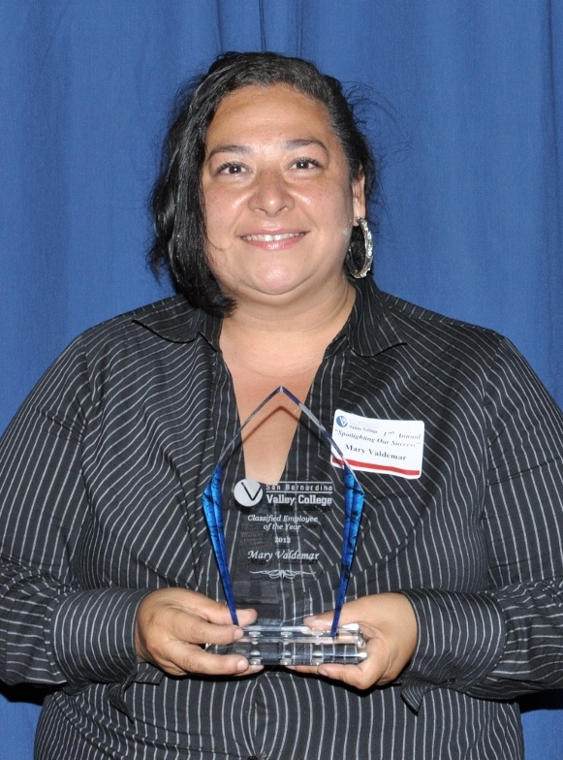
San Bernardino Valley College
Mary Valdemar
Secretary, Financial Aid
Classified Employee of the Year

Slide 30
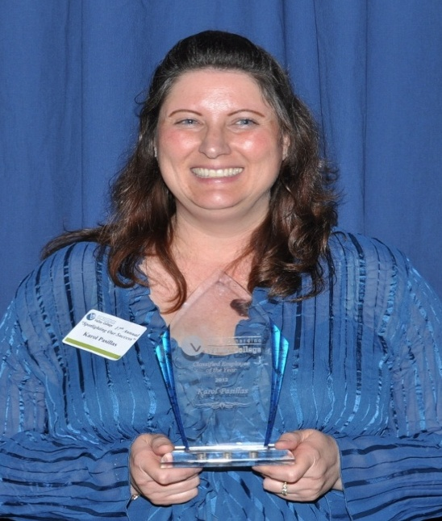
San Bernardino Valley College
Karol Pasillas
Secretary, Office fo the VP of Administrative Services
Classified Employee of the Year

Slide 31
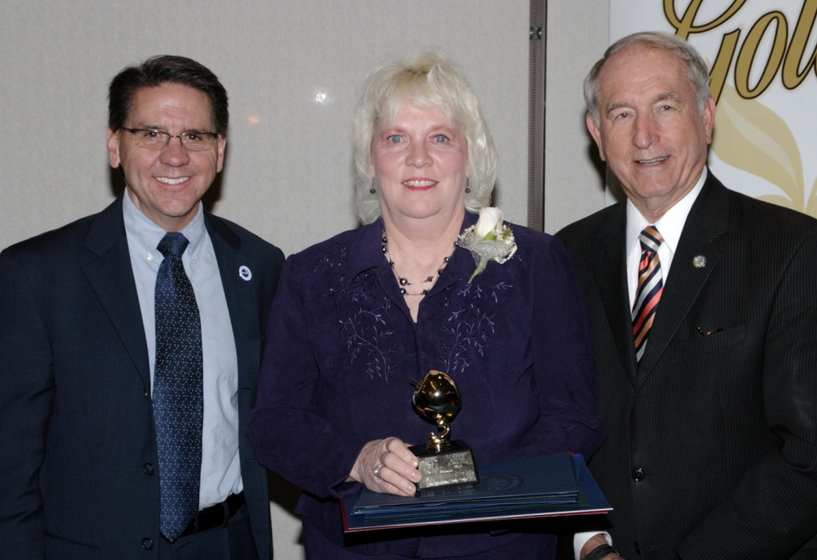
San Bernardino Valley College
Lisa Hepburn-Stroud
Assistant Manager, Bookstore
Golden Apple

Slide 32
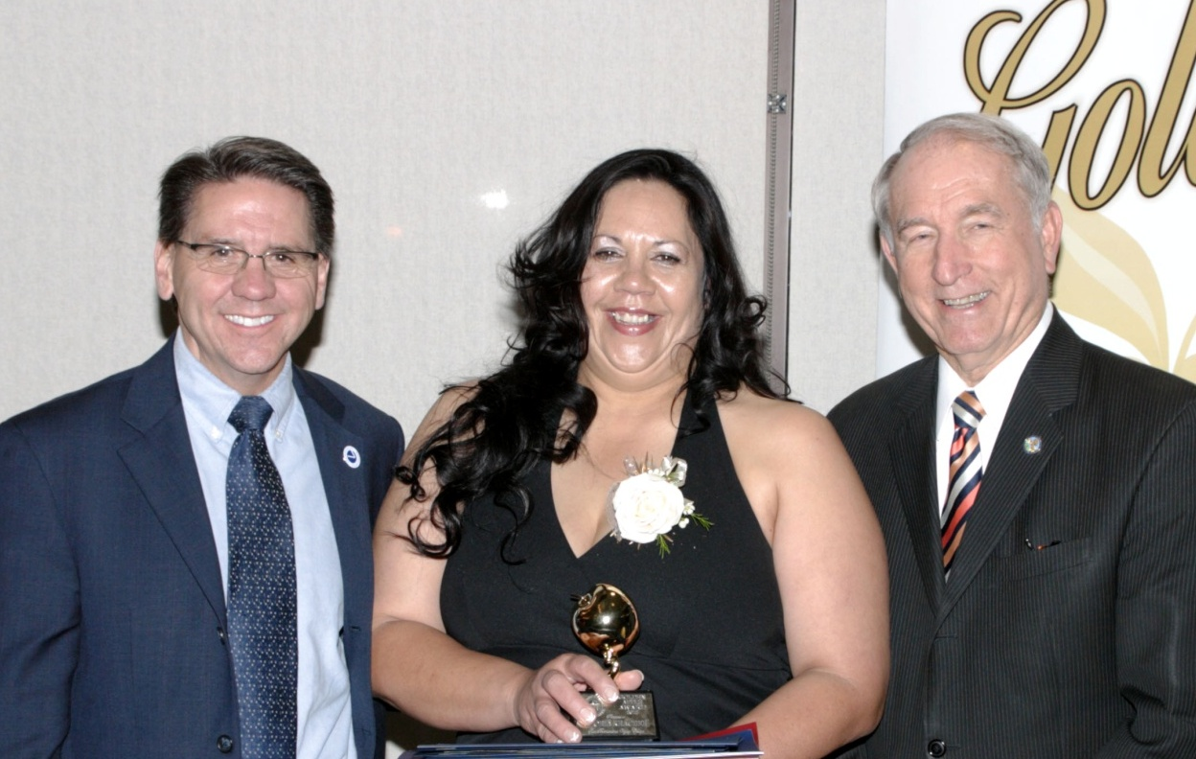
San Bernardino Valley College
Gloria Kracher
Custodian, Maintenance & Operations
Golden Apple

Slide 33
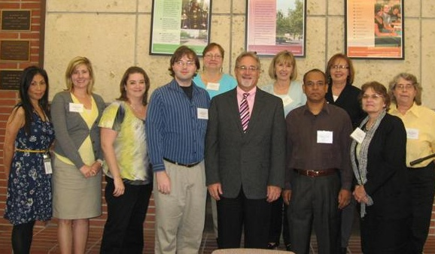
Diablo Valley College
2012 AWARD WINNERS AND NOMINEES
EXEMPLARY CLASSIFIED AWARD

Slide 34
Classified Leadership Institute 2012
Celebrating
Outstanding Classified
Employees
from across
our state
Welcome Aboard

Slide 35
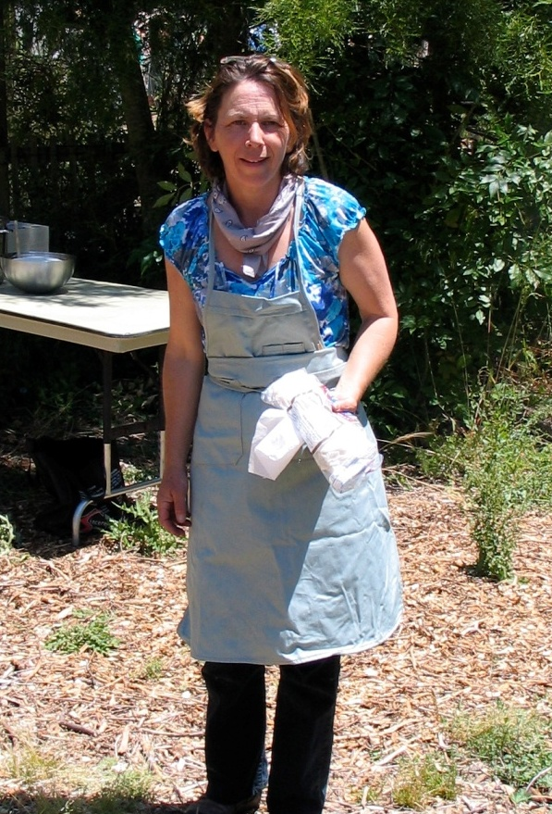
Merritt College
Maura "Molly" Sealund
Science Lab Technician
Classified Senate President

Slide 36
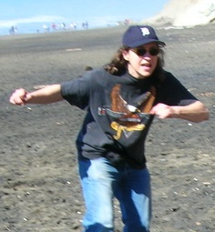
Merritt College
Marilyn Bull
Clerical Assistant
Annual Achievement Award

Slide 37
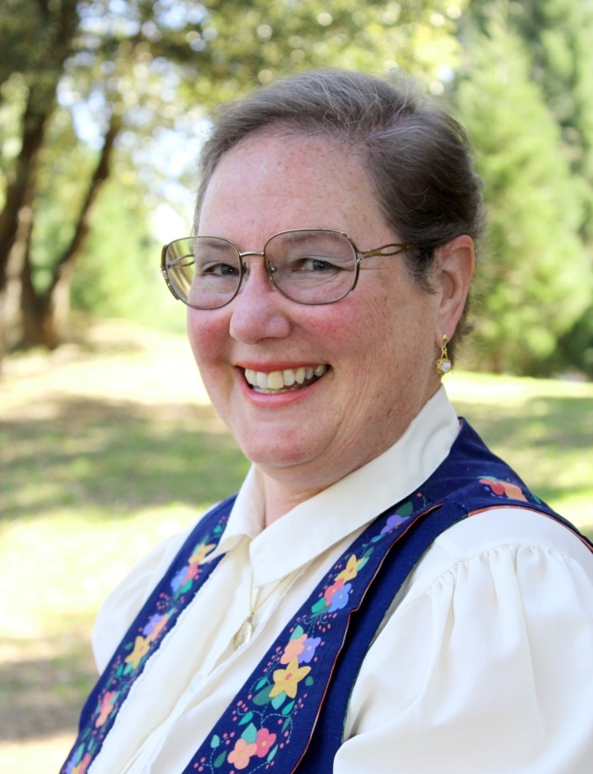
Columbia College
Doreen Bass
Instructional Support Specialist
Classified Employee of the Year

Slide 38
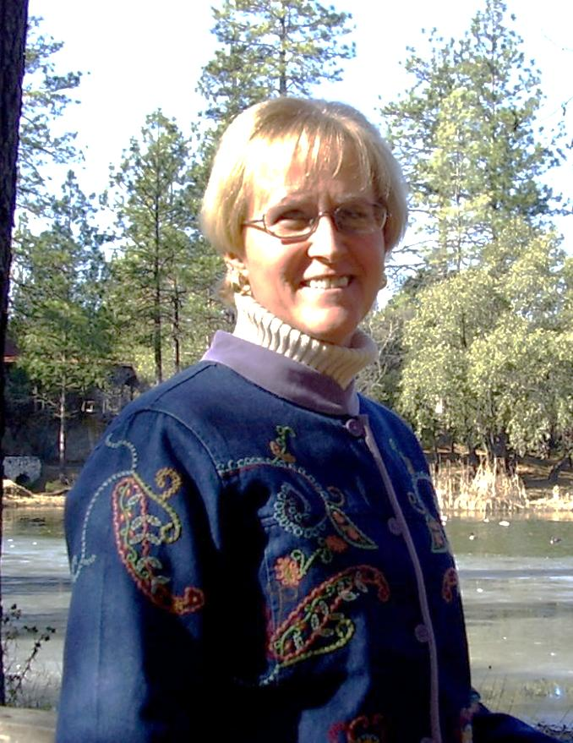
Merritt College
Nancy Bull
Account Technician
Classified Senate President

Slide 39
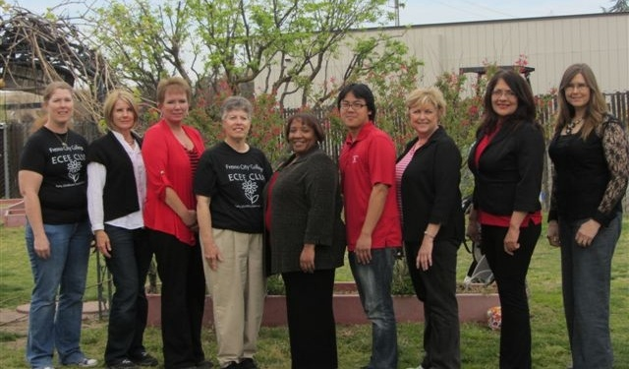
State Center CCD
The Staff of the Child Fresno City College Development Center
SCCCD Classified Professionals of the Year

Slide 40
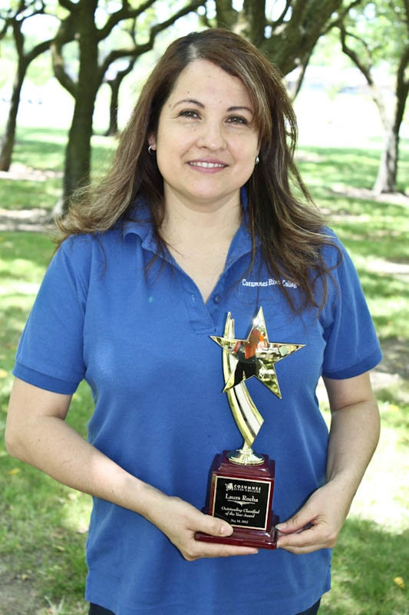
Cosumnes River College
Laura Rocha
Head Custodian
Outstanding Classified Employee of the year 2012

Slide 41
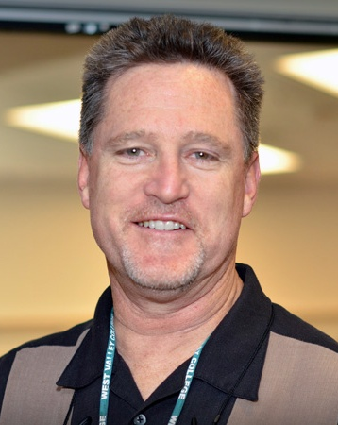
West Valley College
Scott Ludwig
Multimedia Operations Coordinator
Employee of the Year – state chancellor’s office

Slide 42
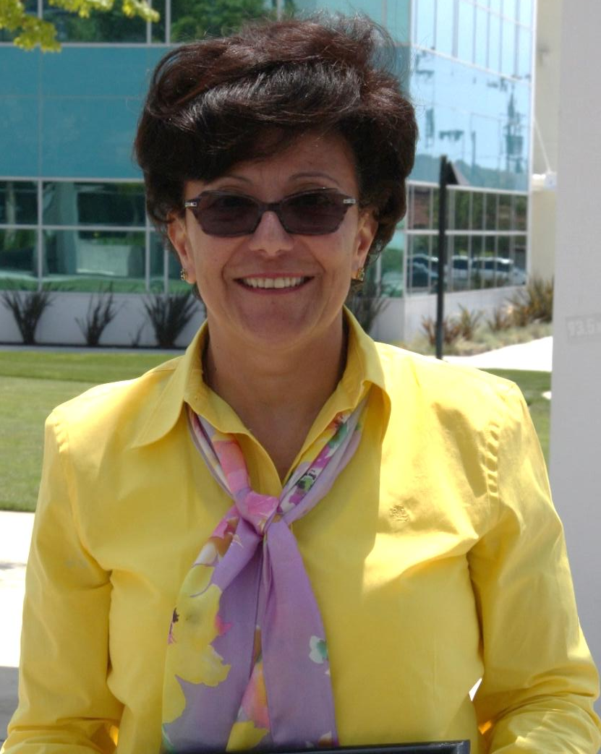
Coastline Community College
Cristina Arellano
Instructional System Design
Unsung Hero Award

Slide 43
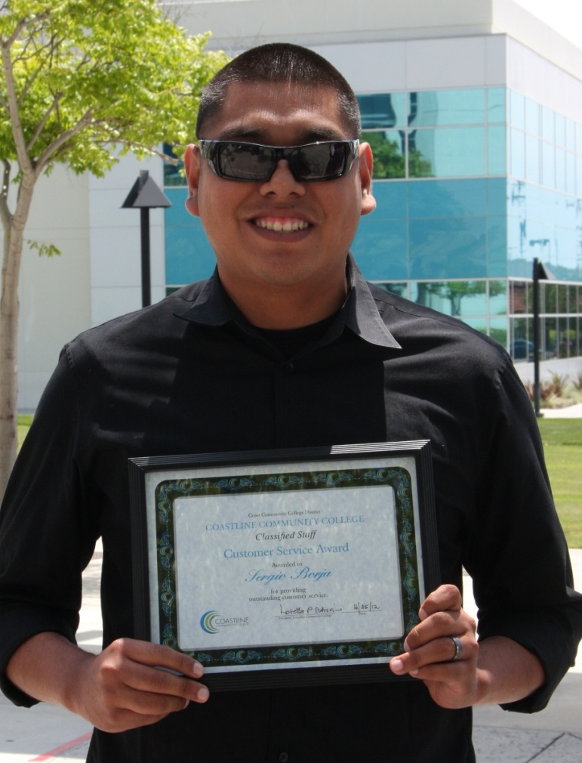
Coastline Community College
Sergio Borja
Admissions & Records Technician II
Customer Service Award

Slide 44
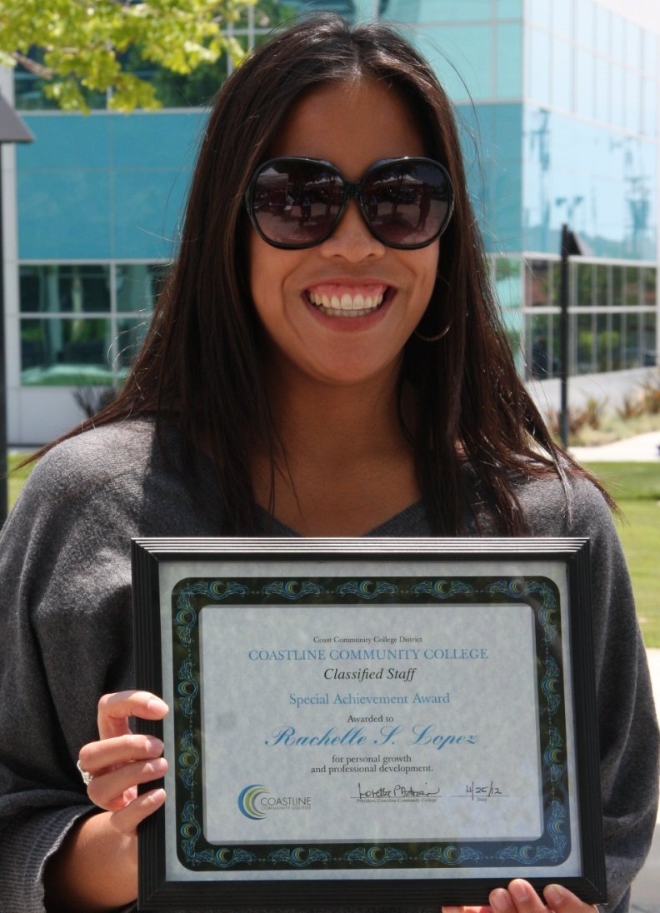
Coastline Community College
Rachelle S. Lopez
International Student
Program Staff Aide - Special Achievement Award

Slide 45
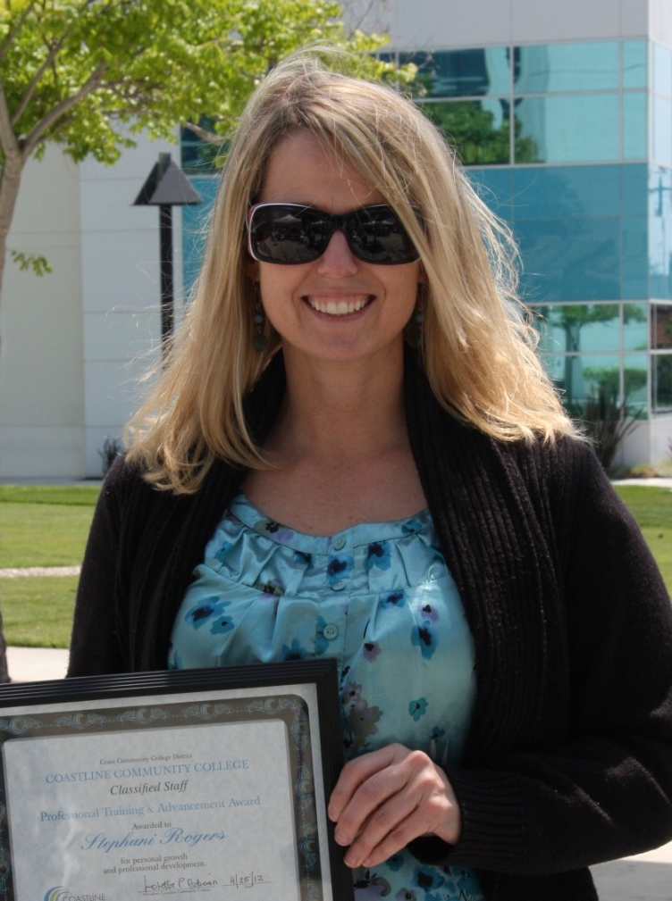
Coastline Community College
Stephani Rogers
Military Technician
Professional Training Award

Slide 46
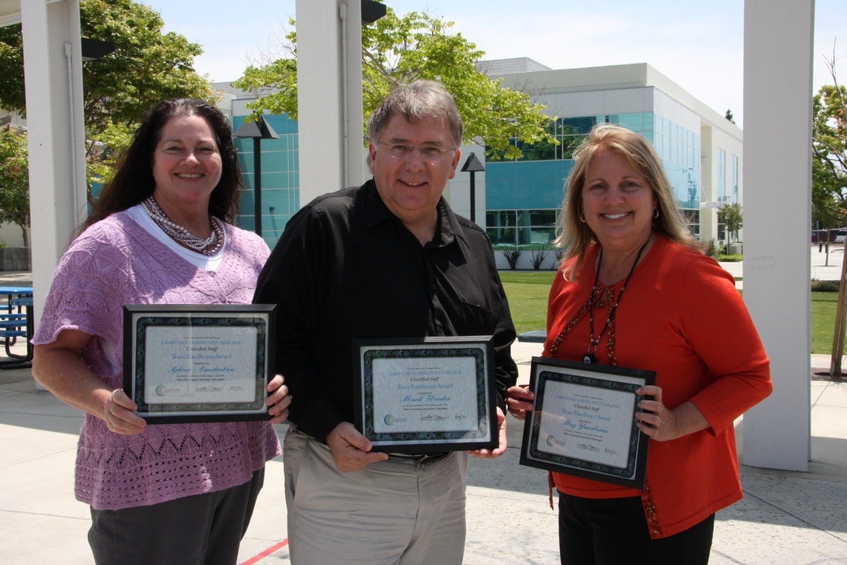
Coastline Community College
Sylvia Amitoelau, Mark Worden, Meg Yanalunas
Office of Learning & Information Technologies
Team Excellence Award

Slide 47
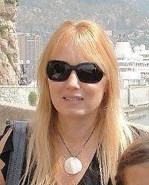
College of Marin
Andrea Hunter
Financial Aid Specialist
Classified Senate President

Slide 48
College of Marin
Shook Chung
Senior Creative Designer
Outstanding Individual Award

Slide 49
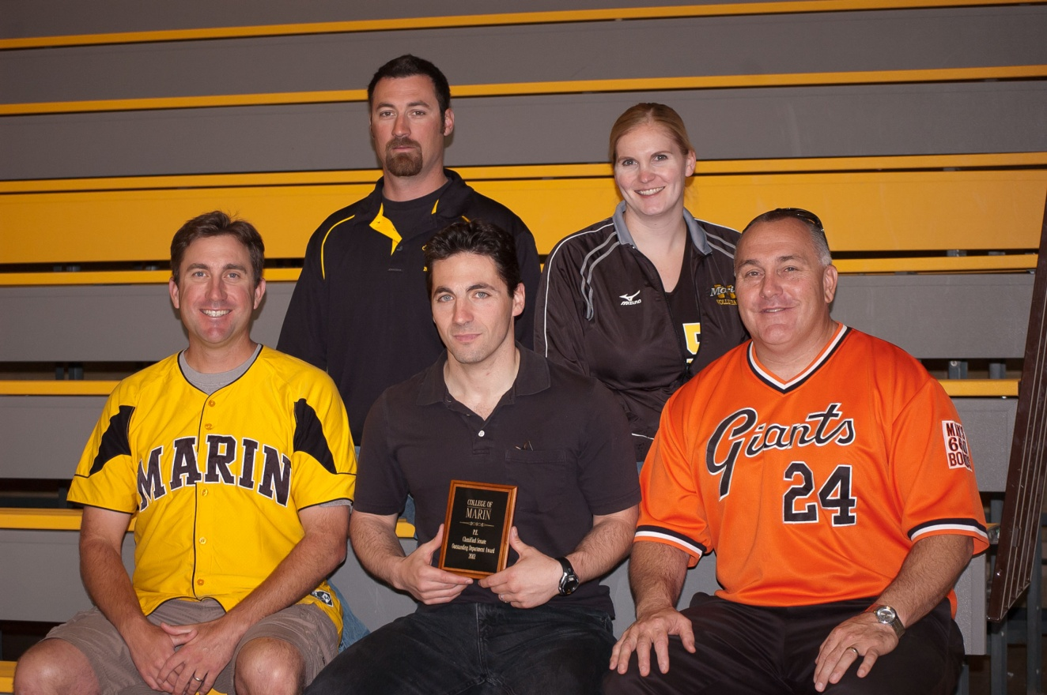
College of Marin
P.E. Department
Outstand Department Award - Classified Senate Appreciation Award

Slide 50
College of Marin
Kate Dodele Office Technician
Unsung Hero Award

Slide 51
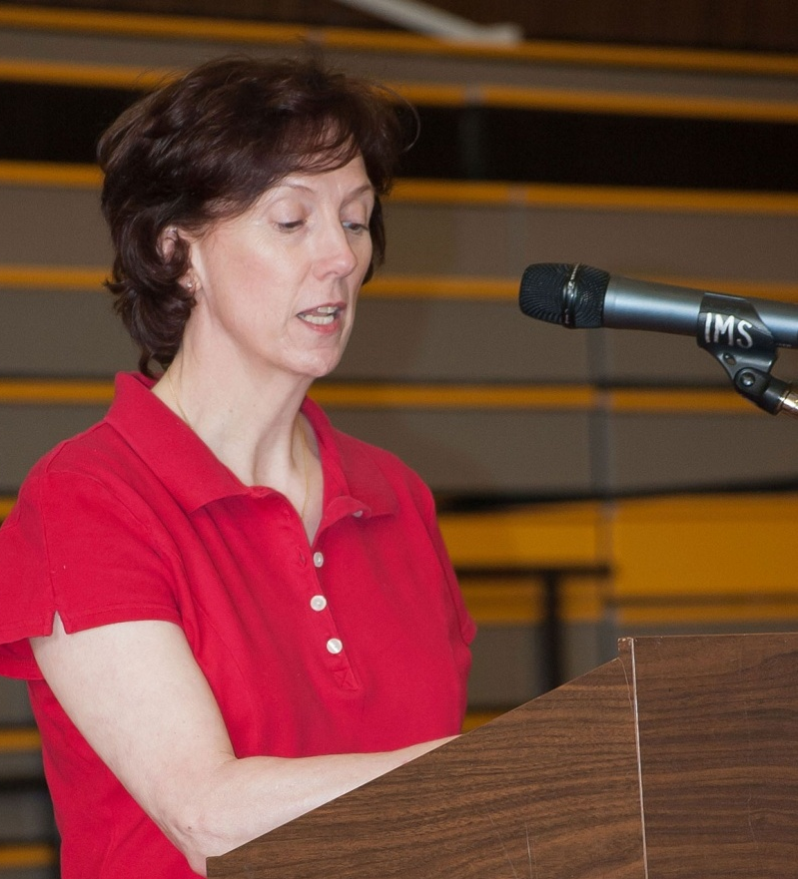
College of Marin
Alice Dieli Laboratory Technician
Outstanding Individual Award Classified Senate Appreciation Award

Slide 52
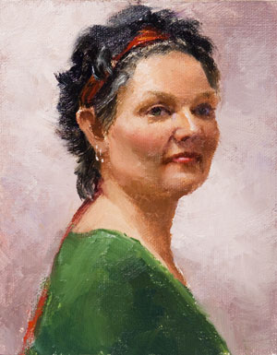
Berkeley City College
Paula Coil
Coordinator, Transfer & Career Information Center
Classified Senate President

Slide 53
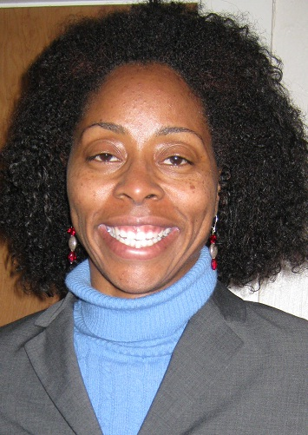
LANEY COLLEGE
MILDRED LEWIS
CARE Coordinator/Program Specialist
CLASSIFIED EMPLOYEE OF THE YEAR

Slide 54
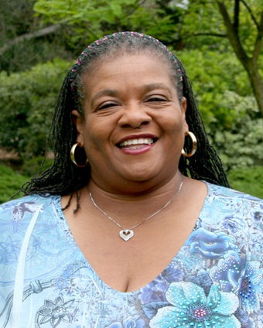
San Diego Miramar College
Terrie Hubbard
Administrative Technician, Office of Instruction
Miramar College Classified Employee of the Year

Slide 55
West Valley College
Laurel Kinley
Administrative Specialist - Personnel
Classified Senate President

Slide 56
Contra Costa ccd
Kim Christiana
Senior Application Support Analyst
Classified Employee of the year

Slide 57
Contra Costa ccd
Greg Evilsizer
IT ,Sr. Network and Computer Specialist
Classified Senate President

Slide 58
Classified Leadership Institute 2012
Celebrating
Outstanding Classified
Employees
from across
our state
Welcome Aboard

Slide 59
CLI Scholarship Recipients
James Blake
Laney College

Slide 60
CLI Scholarship Recipients
Debbie Weatherly
Santa Rosas Junior College

Slide 61
4CS Leadership Award Recipient
Cherie
Savage
Cclc Event
coordinator

Slide 62
CLI Scholarship Recipients
Cristina Arellano
Coastline Community College

Slide 63
Jim Wilson Scholarship
Katie Juras
Sierra College

Slide 64
Grossmont-cuyamaca ccd
Maria baeza
Student services specialist
Chancellor/Classified senate quarterly award

Slide 65
Grossmont-cuyamaca ccd
John thomas
Ornamental horticulture technician
Chancellor/Classified senate quarterly award

Slide 66
Grossmont-cuyamaca ccd
Al ventura
Ceramics technician
Chancellor/Classified senate quarterly award

Slide 67
Grossmont-cuyamaca ccd
Dave Steinmetz
Instructional media services coordinator
Chancellor/Classified senate quarterly award

Slide 68
Grossmont-cuyamaca ccd
Wendy corbin
Benefits technician
Chancellor/Classified senate quarterly award

Slide 69
Grossmont college
Pat Murray
Health Science Lab technician
Employee of the year – state chancellor’s office

Slide 70
Board of governor's award
Doris Hinkley-Hankins, Peralta CCD Kim Christiana - Contra Costa CCD Scott Ludwig, West Valley Mission CCD Pat Murray, Grossmont-Cuyamaca CCD John Welch, Cabrillo CCD

